Slide 1
EPFL Space Center eSpace
Space Propulsion ENG-510

Slide 2


Lecture # 4 Introduction & General Course Information
Brief update on space propulsion course

Slide 3
Oral Exam
Exercise Date:
Oral exam will take place on Wednesday, July 2 and Thursday, July 3 between 9 am and 5 pm
Excel spreadsheet with time slots will be uploaded next week on Moodle
Please book your timeslots starting from Tuesday, April 8
First in, first choice
L4 - Introduction
Space Propulsion ENG-510

Slide 4
Special Lecture
Special Lecture:
Presentation on Electric Thrusters in VLEO + Test Facilities for Electric Thruster at EPFL will be given on Tuesday, May 27
L4 - Introduction
Space Propulsion ENG-510

Slide 5
Test Facility Visit
ERT Test Facility Visit (including firing demonstration):
Test facility visit is proposed for Wednesday, May 28 starting between 9 to 10 am
Who is interested to join?
Agenda:
Test facility tour
Hot firing test (TBC)
L4 - Introduction
Space Propulsion ENG-510

Slide 6
LOx/LH2 versus LOx/LCH4
Sustainability:
Which propellant combination is more sustainable?
It is difficult to compare the two fuel propellants
The pollution from Hydrogen mainly comes from the electricity used on ground to produce it
During the combustion mainly Water vapor is released which is the first greenhouse gas
For Methane the extraction and production is not that high compared to Hydrogen
On flight it releases several particles and it is not known today how soot is developed in the plume
And effects of emissions in the upper atmosphere are poorly known
L4 - Introduction
Space Propulsion ENG-510

Slide 7
LOx/LH2 versus LOx/LCH4
Sustainability:
Which propellant combination is more sustainable?
So potentially Methane as we lack knowledge on impact of sooth in upper atmosphere…
L4 - Introduction
Space Propulsion ENG-510

Slide 8
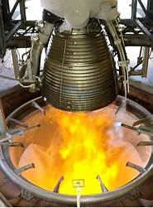
Lecture # 4 Part # 3 Introduction in Propulsion Systems
Brief overview on all space propulsion systems

Slide 9
Which Chemical Propulsion Systems exist?
Objective: To develop the basics of chemical propulsion
Thermal Propulsion Systems
Material Ejection
L4 – Propulsion Systems
Space Propulsion
Space Propulsion ENG-510
Chemical Propulsion Systems
Non-Material Ejection
Electrical Propulsion Systems

Slide 10
Which Chemical Propulsion Systems exist?
Gaseous propulsion systems
Liquid propulsion systems
Gelled propulsion systems
Combustion
Hybrid propulsion systems
L4 – Propulsion Systems
Chemical Propulsion Systems
Space Propulsion ENG-510
Solid propulsion systems
Gaseous Propellant Detonation
Detonation
Liquid Propellant Detonation

Slide 11
Which Chemical Propulsion Systems exist?
Propellant Phase in Tanks
Solid
Liquid
Gas
Bi-prop Thruster
Bipropellant Thruster
Double base or composite
LOx / LH2 – LOx / LCH4 – MON / MMH – HTP / Ethanol
GOx / GCH4
Objective: To develop the basics of chemical propulsion
Chemical Propulsion Systems
Gaseous propulsion systems
Liquid propulsion systems
Gelled propulsion systems
Solid propulsion systems
Hybrid (liquid / solid) propulsion systems
Combustion
Gelled
Liquid Thruster
Solid / Liquid
Hybrid Thruster Bi-prop
L4 – Propulsion Systems
Space Propulsion ENG-510
Chemical Reaction
HTP / IPA
Decomp
Hydrazine (N2H4) HTP (H2O2) ADN
Monopropellant Thruster
No

Slide 12
Which Chemical Propulsion Systems exist?
Gaseous propulsion systems
Liquid propulsion systems
Gelled propulsion systems
Combustion
Hybrid propulsion systems
L4 – Propulsion Systems
Chemical Propulsion Systems
Space Propulsion ENG-510
Solid propulsion systems
Rotation Detonation Engine
Detonation
Pulse Detonation Engine

Slide 13
Which Chemical Propulsion Systems exist?
Tri-propellant
Mono-propellant
Liquid propulsion systems
Combustion
Bi-propellant
L4 – Propulsion Systems
Chemical Propulsion Systems
Space Propulsion ENG-510
Rotation Detonation Engine
Detonation
Pulse Detonation Engine

Slide 14
Which Chemical Propulsion Systems exist?
Tri-propellant
Mono-propellant
Liquid propulsion systems
Combustion
Bi-propellant
L4 – Propulsion Systems
Chemical Propulsion Systems
Space Propulsion ENG-510
Rotation Detonation Engine
Detonation
Pulse Detonation Engine

Slide 15
Which Liquid Mono-propellant Propulsion Systems exist?
Objective: To develop the basics of liquid combustion mono-propellant propulsion
Liquid propulsion systems
Monopropellant, bi-propellant or tri-propellant
Storable or cryogenic propellants
Toxic or non-toxic (hazardous or green) propellants
Hypergolic or non-hypergolic propellants
Pressure-fed (self-pressurization, blow-down or regulated) or pump-fed propulsion
L4 – Propulsion Systems
Space Propulsion ENG-510

Slide 16
Which Liquid Mono-propellant Propulsion Systems exist?
Propellant Phase in Tanks
Solid
Liquid
Gas
Objective: To develop the basics of chemical liquid mono-propellant propulsion
Liquid propulsion systems
kit
Combustion
L4 – Propulsion Systems
Space Propulsion ENG-510
Chemical Reaction
Decomp
Hydrazine (N2H4) / HTP (H2O2) / ADN / HAN / LMP
Monopropellant Thruster
HAN..Hydroxyl Ammonium Nitrate
ADN…Ammonium Di-Nitramide
LMP-103S…ADN + Methanol + Water + Ammonia
No

Slide 17
Which Liquid Mono-propellant Propulsion Systems exist?
Objective: To develop the basics of chemical liquid mono-propellant propulsion
Liquid propulsion systems
kit
L4 – Propulsion Systems
Space Propulsion ENG-510

Slide 18
Which Liquid Mono-propellant Propulsion Systems exist?
Objective: To develop the basics of chemical liquid combustion mono-propellant propulsion
Architecture for liquid mono-propellant decomposition propulsion systems:
L4 – Propulsion Systems
Space Propulsion ENG-510
R
Tank
Regulator
Exhaust
Pressurant
Tank
Valve
Catalysator

Slide 19
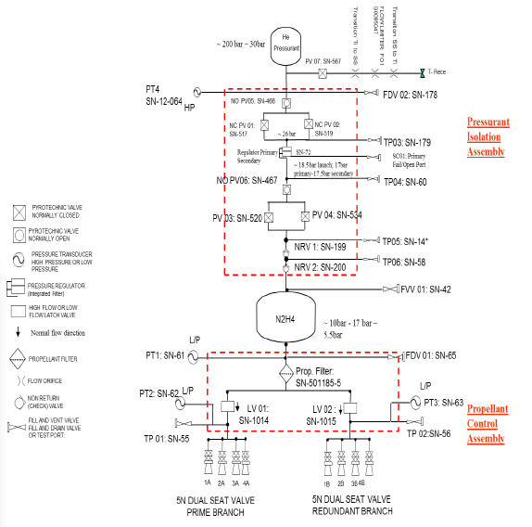
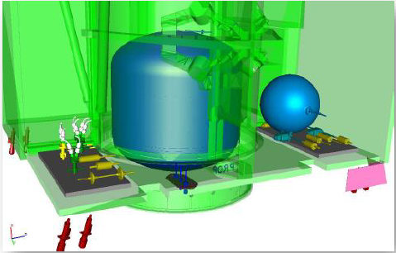
Which Liquid Mono-propellant Propulsion Systems exist?
Objective: To develop the basics of chemical liquid combustion mono-propellant propulsion
Example: Pressure-regulated
L4 – Propulsion Systems
Space Propulsion ENG-510

Slide 20
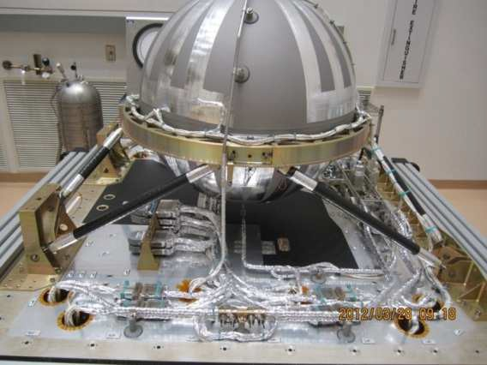
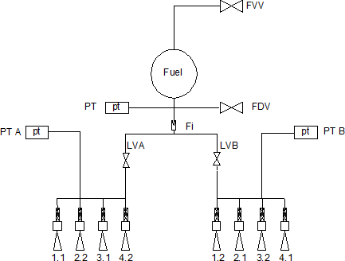
Which Liquid Mono-propellant Propulsion Systems exist?
Objective: To develop the basics of chemical liquid combustion mono-propellant propulsion
Example: Blow-down
L4 – Propulsion Systems
Space Propulsion ENG-510

Slide 21
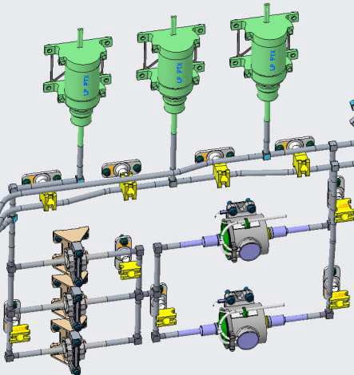
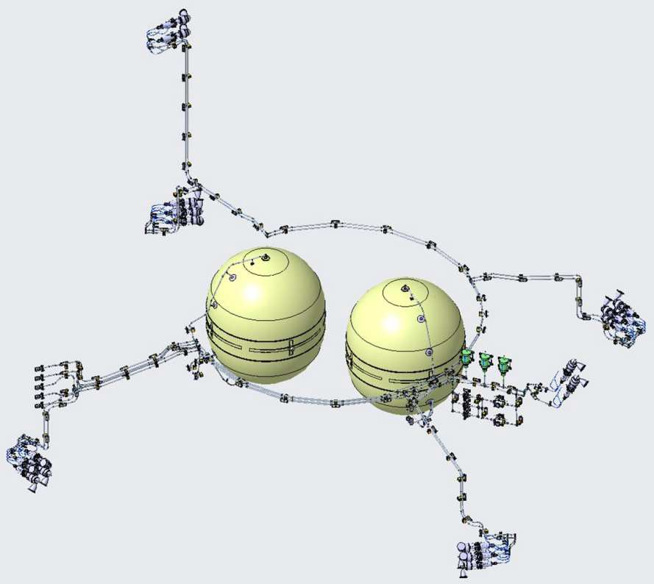
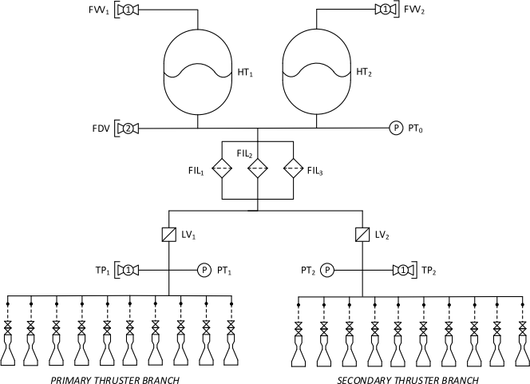
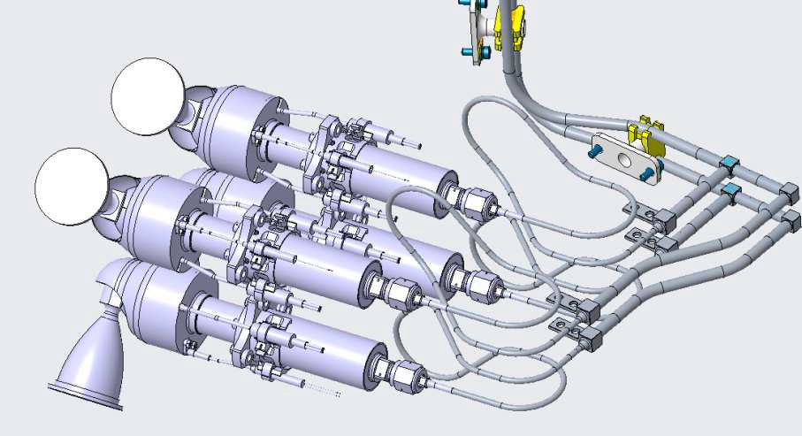
Which Liquid Mono-propellant Propulsion Systems exist?
Objective: To develop the basics of chemical liquid combustion mono-propellant propulsion
Mono-propellant propulsion systems (including redundancy)
L4 – Propulsion Systems
Space Propulsion ENG-510

Slide 22
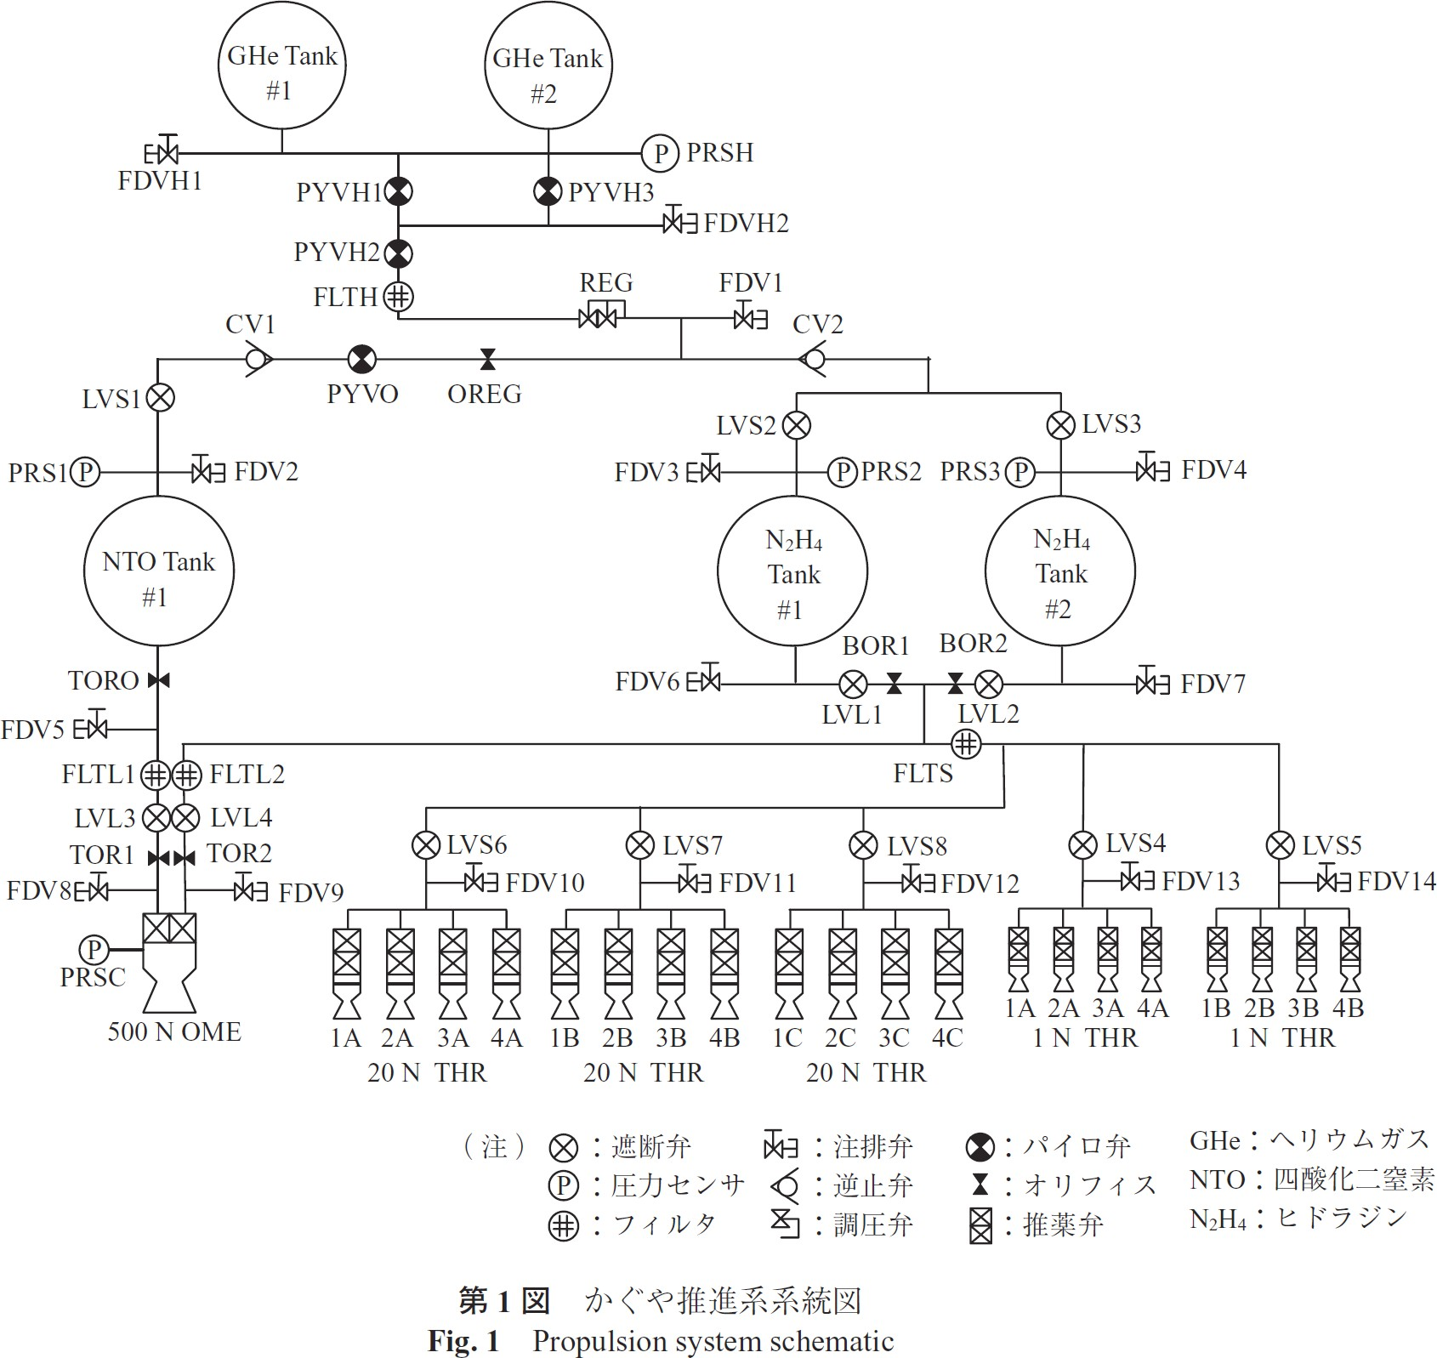
Which Liquid Mono-propellant Propulsion Systems exist?
Objective: To develop the basics of chemical liquid combustion mono-propellant propulsion
Mono-propellant propulsion System
Bi-prop
Mono-prop
L4 – Propulsion Systems
Space Propulsion ENG-510

Slide 23
Which Liquid Mono-propellant Propulsion Systems exist?
Pressurization (blow-down)
Objective: To develop the basics of chemical liquid combustion mono-propellant propulsion
Mono-propellant propulsion System
Oxidizer
Fuel
L4 – Propulsion Systems
Space Propulsion ENG-510

Slide 24
Which Liquid Mono-propellant Propulsion Systems exist?
Objective: To develop the basics of chemical liquid combustion mono-propellant propulsion
Characteristics of a mono-propellant propulsion system
Relatively simple, robust, cheap
Toxic propellant (Hydrazine is very often used) but also more and more ‘green’
Catalysator is needed for decomposition
Blow-down mode is very often used (ratio of 4 to 1)
Pressure range between 5.5 bar to 24.6 bar
Isp is between 210 to 230 s (Exhaust velocity of 2.0 km / s to 2.3 km / s)
Thrust between 1 N to 1 kN
Modular set-up is possible using COTS (cost optimization)
Temperature and heat exchange must be controlled
L4 – Propulsion Systems
Space Propulsion ENG-510

Slide 25
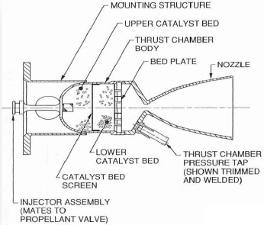
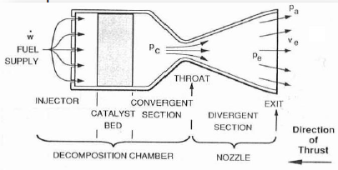
Which Liquid Mono-propellant Propulsion Systems exist?
25
Objective: To develop the basics of chemical liquid combustion mono-propellant propulsion
Mono-propellant propulsion system thruster design
L4 – Propulsion Systems
Space Propulsion ENG-510

Slide 26
Which Liquid Mono-propellant Propulsion Systems exist?
Valve
(not shown)
Decomposition
Chamber with
Catalyst
Catalyst
Heater
26
Thermal
Barrier
Objective: To develop the basics of chemical liquid combustion mono-propellant propulsion
Mono-propellant propulsion System
Injection Head
Injection Tube
L4 – Propulsion Systems
Throat
Space Propulsion ENG-510

Slide 27
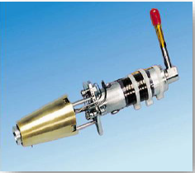
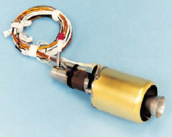
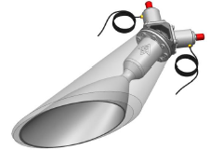
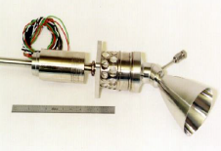
Which Liquid Mono-propellant Propulsion Systems exist?
Objective: To develop the basics of chemical liquid combustion mono-propellant propulsion
Mono propellant propulsion system
L4 – Propulsion Systems
Space Propulsion ENG-510
Scarved Thruster
Canted Thruster

Slide 28
Which Liquid Mono-propellant Propulsion Systems exist?
Objective: To develop the basics of chemical liquid combustion mono-propellant propulsion
Thruster design:
Catalyst bed must be heated prior to firing
Typically takes 45 minutes to reach temperature of ~ 250 °C
Thruster can be fired cold (< 10 °C) however the degradation increases
Typically a thruster will have been qualified to 10 to 15 cold starts as part of the life test (safe mode recovery)
The thruster can also be started between 10 and 250 °C (pre-heat start) but number of starts will also be limited (~ 1000 starts)
Once the thruster has performed one cold start, the temperature will be in the pre-heat range from the thrust reaction
Catalyst is made from Alumina granules, with Iridium coating
L4 – Propulsion Systems
Space Propulsion ENG-510

Slide 29
Which Liquid Mono-propellant Propulsion Systems exist?
Objective: To develop the basics of chemical liquid combustion mono-propellant propulsion
Thruster design:
Catalyst is made from Alumina granules, with Iridium coating
Catalyst bed is susceptible to:
Catalyst poisoning –amines and silicates particularly
High gas flow will damage the catalyst bed
L4 – Propulsion Systems
Space Propulsion ENG-510

Slide 30
Which Liquid Mono-propellant Propulsion Systems exist?
Objective: To develop the basics of chemical liquid combustion mono-propellant propulsion
Functional principal for liquid mono-propellant decomposition propulsion systems:
Exothermal decomposition of Hydrazine
Hot gas is accelerated in the Nozzle and ejected
Typical catalysator are S405 or KC12GA
Reaction equation: 3N2H4 -> 4NH3 + N2 4NH3 -> 2N2 + 6H2
L4 – Propulsion Systems
Space Propulsion ENG-510

Slide 31
Which Liquid Mono-propellant Propulsion Systems exist?
Objective: To develop the basics of chemical liquid combustion mono-propellant propulsion
Hydrazine (N2H4) Characteristics
Hydrazine: colourless hygroscopic liquid, oily, flammable,
Stable chemical, can be stored for long periods of time without loss of purity
Boiling point = 113.5 °C, Freezing point = 2 °C
Density ~ 1008 kg/m³ at 20 °C
Fumes in air with vapours which are 4 % heavier than air
Fishy Ammonia-like odour detectable at a mean of 3.7 ppm
L4 – Propulsion Systems
Space Propulsion ENG-510

Slide 32
Which Liquid Mono-propellant Propulsion Systems exist?
Objective: To develop the basics of chemical liquid combustion mono-propellant propulsion
Hydrazine is a hazardous chemical!
Air vapour mixture can be highly flammable
Can cause fire on contact with rust
Protective clothing and breathing apparatus must be worn
Can detonate if subjected to physical shock (rapid adiabatic compression e.g. during priming)
L4 – Propulsion Systems
Space Propulsion ENG-510

Slide 33
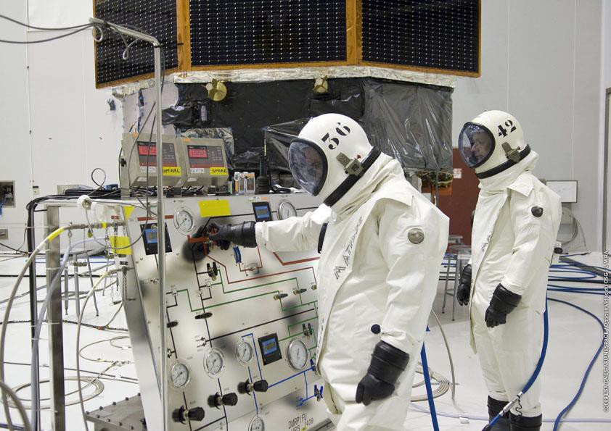
Which Liquid Mono-propellant Propulsion Systems exist?
Objective: To develop the basics of chemical liquid combustion mono-propellant propulsion
L4 – Propulsion Systems
Space Propulsion ENG-510

Slide 34
Which Liquid Mono-propellant Propulsion Systems exist?
Objective: To develop the basics of chemical liquid combustion mono-propellant propulsion
‘Greener’ propellant…
HTP – High Test Peroxide (H2O2 – Hydrogen Peroxide concentration > 85 %)
ADN
HAN
LMP-103S
In principle very similar to Hydrazine [N2H4] but potentially some specific features like decomposition, catalyst composition, heating, …
Catalyst lifetime…
Density Isp…
L4 – Propulsion Systems
Space Propulsion ENG-510

Slide 35
Which Liquid Mono-propellant Propulsion Systems exist?
Objective: To develop the basics of chemical liquid combustion mono-propellant propulsion
‘Greener’ propellant…
Energetic ionic liquids
By definition, an ionic liquid is a salt with a melting point below 100 °C used in the liquid state
Ionic liquid mono propellants are usually mixtures of an oxidizer salt, a fuel and water
The most studied oxidizer salts for propellant applications are HNF (Hydraziniumnitroformate), HAN (Hydroxylammoniumnitrates) and ADN (Ammoniumdinitramide)
Two ADN formulations LMP-103S and FLP-106, have received particular attention in Europe
L4 – Propulsion Systems
Space Propulsion ENG-510

Slide 36
Which Liquid Mono-propellant Propulsion Systems exist?
Objective: To develop the basics of chemical liquid combustion mono-propellant propulsion
‘Greener’ propellant…
Energetic ionic liquids
LMP-103S has been selected by the Swedish company ECAPS
A successful in-space demonstration was achieved on the PRISMA mission, using 1 N thrusters and the monopropellant LMP-103S
Since then the HPGP technology based on LMP-103S now provides a low-hazardous and flight-proven, performance enhancer for small and secondary satellites
L4 – Propulsion Systems
Space Propulsion ENG-510

Slide 37
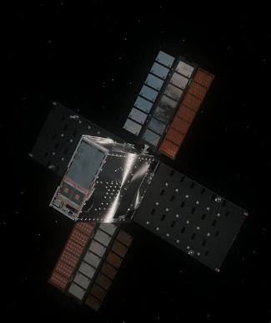
Which Liquid Mono-propellant Propulsion Systems exist?
Objective: To develop the basics of chemical liquid combustion mono-propellant propulsion
‘Greener’ propellant…
Energetic ionic liquids
An important HAN formulation is the monopropellant AF- M315E respectively ASCENT (Advanced Spacecraft Energetic Non-Toxic Propellant)
The ASCENT propellant is used on the NASA cube sat mission which failed to go into orbit around the moon earlier 2023 when debris blocked propellant lines for the spacecraft’s thrusters
Otherwise it could be stated that the propellant has performed a successful in-orbit demonstration as it is suspected that foreign object debris somewhere in the propulsion system caused the thruster problems
L4 – Propulsion Systems
Space Propulsion ENG-510

Slide 38
Which Liquid Mono-propellant Propulsion Systems exist?
Objective: To develop the basics of chemical liquid combustion mono-propellant propulsion
‘Greener’ propellant…
Nitrous oxide
Another promising class of Green Propellants are the so called nitrous oxide fuel blends
Those fuel blends consist of nitrous oxide mixed with different hydrocarbons (e.g. C2H2, C2H4, or C2H6)
To obtain the propellant, the single components are pressurized, cooled (down to about 220K) and mixed
Characteristic for the blends are the high vapor pressures, which could enable self-pressurization of the whole propulsion system
One the one hand the high reactivity of the mixture offers the opportunity of a simple ignition system (e.g. a spark plug)
L4 – Propulsion Systems
Space Propulsion ENG-510

Slide 39
Which Liquid Mono-propellant Propulsion Systems exist?
Objective: To develop the basics of chemical liquid combustion mono-propellant propulsion
‘Greener’ propellant…
Nitrous oxide
On the other hand, the whole propulsion system needs a proper flashback arrestor to avoid flame propagation into the tank during all possible operation modes
Another challenging aspect is the high combustion temperature of those premixed propellants
A reliable cooling system must be established to handle combustion temperatures up to 3500 K
L4 – Propulsion Systems
Space Propulsion ENG-510

Slide 40
Which Liquid Mono-propellant Propulsion Systems exist?
Objective: To develop the basics of chemical liquid combustion mono-propellant propulsion
‘Greener’ propellant…
Nitrous oxide
A significant advantage of the nitrous oxide fuel blends is their high Isp
Depending on the mixture composition, an increase of 100 s compared to hydrazine is possible
Furthermore only minor health hazards arise, dealing with those propellant mixtures
So cheaper and easier handling seems to be possible
L4 – Propulsion Systems
Space Propulsion ENG-510

Slide 41
Which Liquid Mono-propellant Propulsion Systems exist?
Objective: To develop the basics of chemical liquid combustion mono-propellant propulsion
‘Greener’ propellant…
Nitrous oxide
But…
Three people have been killed and numerous persons injured by a prior explosion involving (nitrous oxide) in the motor design of Virgin Galactic space ship
A report by the California Division of Occupational Safety and Health said the 2007 blast occurred three seconds after the start of a cold-flow test of nitrous oxide
The engine was not firing during the test at the Mojave Air and Space Port
L4 – Propulsion Systems
Space Propulsion ENG-510

Slide 42
Which Liquid Mono-propellant Propulsion Systems exist?
Objective: To develop the basics of chemical liquid combustion mono-propellant propulsion
‘Greener’ propellant…
Hydrogen Peroxide
Hydrogen peroxide is a third group of green propellants currently under investigation
Typically the concentration for H2O2 used as a rocket propellant is in between 80 to 90 %
Those concentrations are needed to achieve an Isp of about 150 s as a mono-propellant, which is quite low compared to hydrazine
Characteristic for hydrogen peroxide is its decomposition to O2 and H2O with time
L4 – Propulsion Systems
Space Propulsion ENG-510

Slide 43
Which Liquid Mono-propellant Propulsion Systems exist?
Objective: To develop the basics of chemical liquid combustion mono-propellant propulsion
‘Greener’ propellant…
Hydrogen Peroxide
Due to its reactivity, compatible materials have to be selected carefully
Advantages of H2O2 are its benign effect on environment and the low health hazards
Furthermore a catalytic decomposition is possible and the combustion temperature is significant lower than that of other green propellant candidates
The explosive hazards coming along with the use of hydrogen peroxide need to be more thoroughly investigated
L4 – Propulsion Systems
Space Propulsion ENG-510

Slide 44
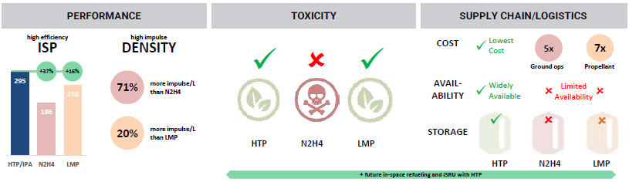
Which Liquid Mono-propellant Propulsion Systems exist?
Objective: To develop the basics of chemical liquid combustion mono-propellant propulsion
‘Greener’ propellant…
L4 – Propulsion Systems
Space Propulsion ENG-510

Slide 45
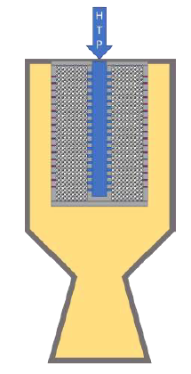
Which Liquid Mono-propellant Propulsion Systems exist?
Objective: To develop the basics of chemical liquid combustion mono-propellant propulsion
Example: Benchmark Space Systems Ocelot thruster using HTP
HTP (High Test Peroxide with concentration of more than 85 % H2O2) provides interesting performance
L4 – Propulsion Systems
Space Propulsion ENG-510

Slide 46
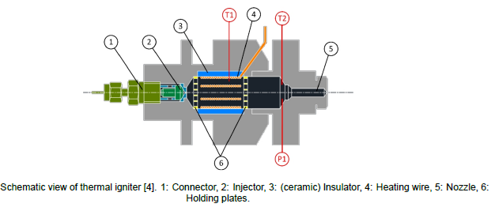
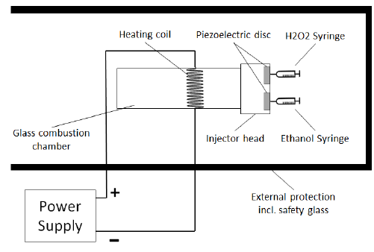
Which Liquid Mono-propellant Propulsion Systems exist?
Objective: To develop the basics of chemical liquid combustion mono-propellant propulsion
Example: TU Delft thruster using HTP
HTP (High Test Peroxide) could also be ignited by thermal decomposition and not only exothermic decomposition (e.g. thermal wire)
L4 – Propulsion Systems
Space Propulsion ENG-510

Slide 47
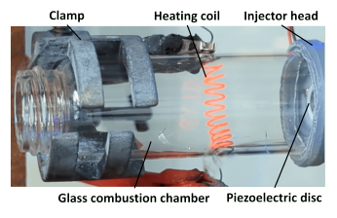
Which Liquid Mono-propellant Propulsion Systems exist?
Objective: To develop the basics of chemical liquid combustion mono-propellant propulsion
Example: TU Delft thruster using HTP
HTP (High Test Peroxide) could also be ignited by thermal decomposition and not only exothermic decomposition (e.g. thermal wire)
L4 – Propulsion Systems
Space Propulsion ENG-510

Slide 48
Which Liquid Mono-propellant Propulsion Systems exist?
Objective: To develop the basics of chemical liquid combustion mono-propellant propulsion
Example: Benchmark Space Systems Ocelot thruster using HTP
But HTP decomposes over time…
L4 – Propulsion Systems
Space Propulsion ENG-510

Slide 49
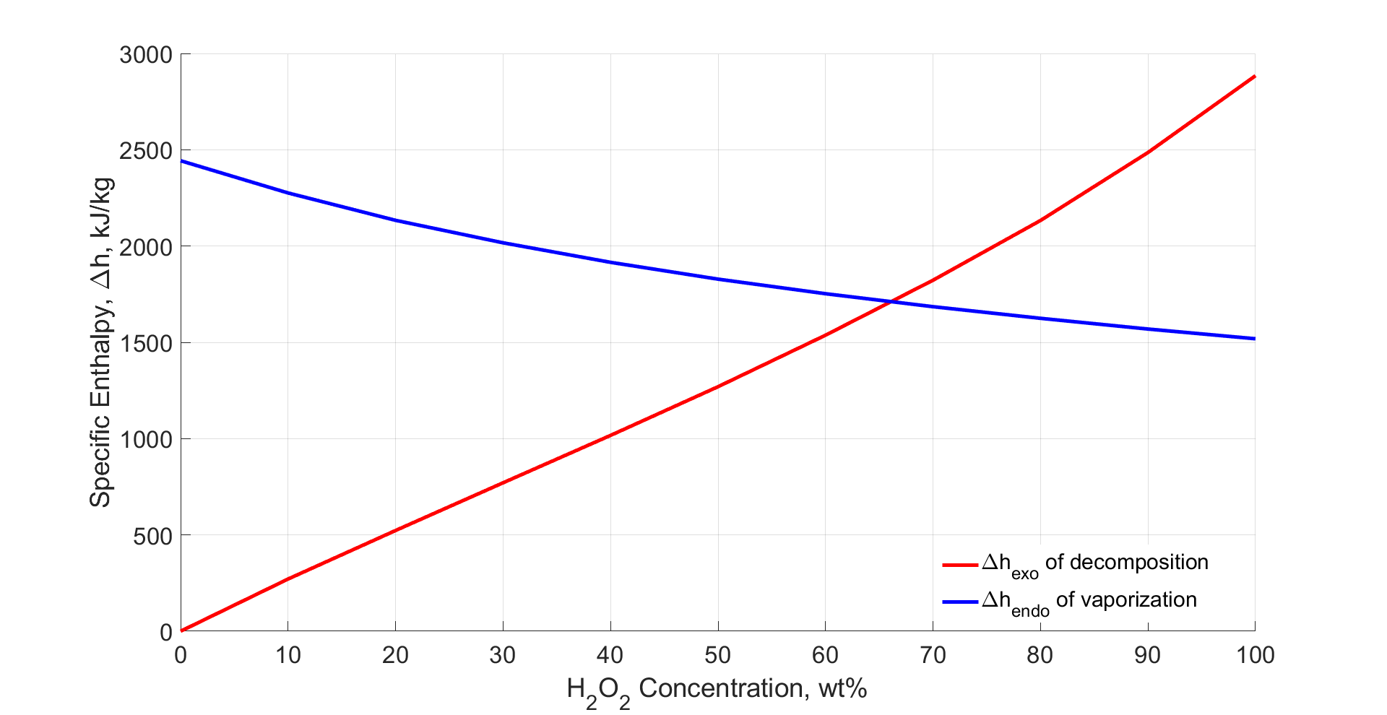
Which Liquid Mono-propellant Propulsion Systems exist?
Objective: To develop the basics of chemical liquid combustion mono-propellant propulsion
Example: Benchmark Space Systems Ocelot thruster using HTP
But HTP decomposes over time…
L4 – Propulsion Systems
Space Propulsion ENG-510

Slide 50
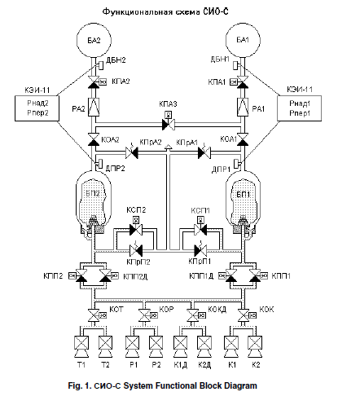
Which Liquid Mono-propellant Propulsion Systems exist?
Objective: To develop the basics of chemical liquid combustion mono-propellant propulsion
Example: Benchmark Space Systems Ocelot thruster using HTP
HTP was used a lot at the beginning of the space race
L4 – Propulsion Systems
Space Propulsion ENG-510

Slide 51
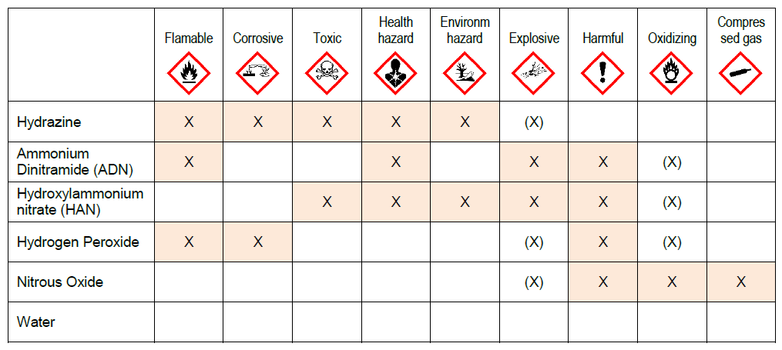
Which Liquid Mono-propellant Propulsion Systems exist?
Objective: To develop the basics of chemical liquid combustion mono-propellant propulsion
A
B
L4 – Propulsion Systems
Space Propulsion ENG-510

Slide 52
Which Liquid Mono-propellant Propulsion Systems exist?
Objective: To develop the basics of chemical liquid combustion mono-propellant propulsion
‘Greener’ propellant…
Green Hydrazine
Blend of Hydrazine with other liquids to 100- to 1000-fold reduced vapor pressure compared to neat hydrazine
Such propellants present a previously-unexplored path to realize the same benefits offered by current high-TRL green ionic liquid propellants while preserving the favorably low operating temperatures and preheat power requirements of heritage monopropellant technologies
L4 – Propulsion Systems
Space Propulsion ENG-510

Slide 53
Which Liquid Mono-propellant Propulsion Systems exist?
Objective: To develop the basics of chemical liquid combustion mono-propellant propulsion
‘Greener’ propellant…
Green Hydrazine
Specifically, green hydrazine-based propellants:
Can be fired in conventional, low-cost nickel-based super-alloy thrusters
Deliver specific impulse equal to hydrazine and 25-35% greater density-specific impulse
Do not require higher catalyst bed preheat temperatures than hydrazine
Remain liquid below -50ºC, potentially obviating the need for feed system heating
L4 – Propulsion Systems
Space Propulsion ENG-510

Slide 54
Which Liquid Mono-propellant Propulsion Systems exist?
Objective: To develop the basics of chemical liquid combustion mono-propellant propulsion
Summary
Monopropellant liquid propulsion systems provide interesting performance for small spacecraft and limited Δv need
Monopropellant systems are getting once again popular by the use of greener propellant
L4 – Propulsion Systems
Space Propulsion ENG-510

Slide 55
Which Liquid Bi-propellant Propulsion Systems exist?
Objective: To develop the basics of chemical L/L combustion bi-propellant propulsion
Liquid propulsion systems
Monopropellant, bi-propellant or tri-propellant
Storable or cryogenic propellants
Toxic or non-toxic (hazardous or green) propellants
Hypergolic or non-hypergolic propellants
Pressure-fed (self-pressurization, blow-down or regulated) or pump-fed propulsion
L4 – Propulsion Systems
Space Propulsion ENG-510

Slide 56
Which Liquid Bi-propellant Propulsion Systems exist?
Objective: To develop the basics of chemical L/L combustion bi-propellant propulsion
A little bit of history…
The idea of liquid rocket as understood in the modern context first appears in the book The Exploration of Cosmic Space by Means of Reaction Devices, by the Russian school teacher Konstantin Tsiolkovsky
This seminal treatise on astronautics was published in May 1903, but was not distributed outside Russia until years later, and Russian scientists paid little attention to it
L4 – Propulsion Systems
Space Propulsion ENG-510

Slide 57
Which Liquid Bi-propellant Propulsion Systems exist?
Objective: To develop the basics of chemical L/L combustion bi-propellant propulsion
A little bit of history…continued
Pedro Paulet wrote a letter to El Comercio in Lima in 1927, claiming he had experimented with a liquid rocket engine while he was a student in Paris three decades earlier
Historians of early rocketry experiments, among them Max Valier, Willy Ley and John D. Clark, have given differing amounts of credence to Paulet's report
Valier applauded Paulet's liquid-propelled rocket design in the Verein für Raumschiffahrt Die Rakete, saying the engine had "amazing power" and that his plans were necessary for future rocket development
L4 – Propulsion Systems
Space Propulsion ENG-510

Slide 58
Which Liquid Bi-propellant Propulsion Systems exist?
Objective: To develop the basics of chemical L/L combustion bi-propellant propulsion
A little bit of history…continued
Wernher von Braun would later describe Paulet as "the pioneer of the liquid fuel propulsion motor" and stated that "Paulet helped man reach the Moon "
The first flight of a liquid-propellant rocket took place on March 16, 1926 at Auburn, Massachusetts, when American professor Dr. Robert H. Goddard launched a vehicle using liquid oxygen and gasoline as propellants
The rocket rose just 41 feet during a 2.5-second flight that ended in a cabbage field, but it was an important demonstration that rockets utilizing liquid propulsion were possible
L4 – Propulsion Systems
Space Propulsion ENG-510

Slide 59
Which Liquid Bi-propellant Propulsion Systems exist?
Propellant Phase in Tanks
Solid
Liquid
Gas
Bipropellant Thruster
LOx / LH2 – LOx / LCH4 – MON / MMH – HTP / Ethanol
Objective: To develop the basics of chemical L/L combustion bi-propellant propulsion
A
B
Combustion
L4 – Propulsion Systems
Space Propulsion ENG-510
Chemical Reaction
HTP / IPA
Decomp
No

Slide 60
Which Liquid Bi-propellant Propulsion Systems exist?
Pressure-fed or pump-fed
Pressurization System
L4 – Propulsion Systems
Space Propulsion ENG-510
Hypergol or not
Cooling concept?
Storable or cryogenic
Toxic or non-toxic

Slide 61
Which Liquid Bi-propellant Propulsion Systems exist?
Objective: To develop the basics of chemical L/L combustion bi-propellant propulsion
Regulator
R
L4 – Propulsion Systems
Regulator
R
Tank
Space Propulsion ENG-510
Valve
Pressurant
Tank
Exhaust
Pressurant
Tank
Valve
Propulsion Drive Electronics
Combustion
PDE

Slide 62
Which Liquid Bi-propellant Propulsion Systems exist?
Objective: To develop the basics of chemical L/L combustion bi-propellant propulsion
Characteristics (advantages) of a Bi-propellant Propulsion System
Highest achievable specific impulse for chemical rocket propulsion
Controllability (on / off control, restart ability, throttable, pulse mode firing which results in important engine parameter for reaction control thruster – minimum impulse bit)
Easy adaptation to launcher or S/C architecture
Possibility of realistic ground testing and pre-launch check-out
Enable component redundancy to virtually any level
L4 – Propulsion Systems
Space Propulsion ENG-510

Slide 63
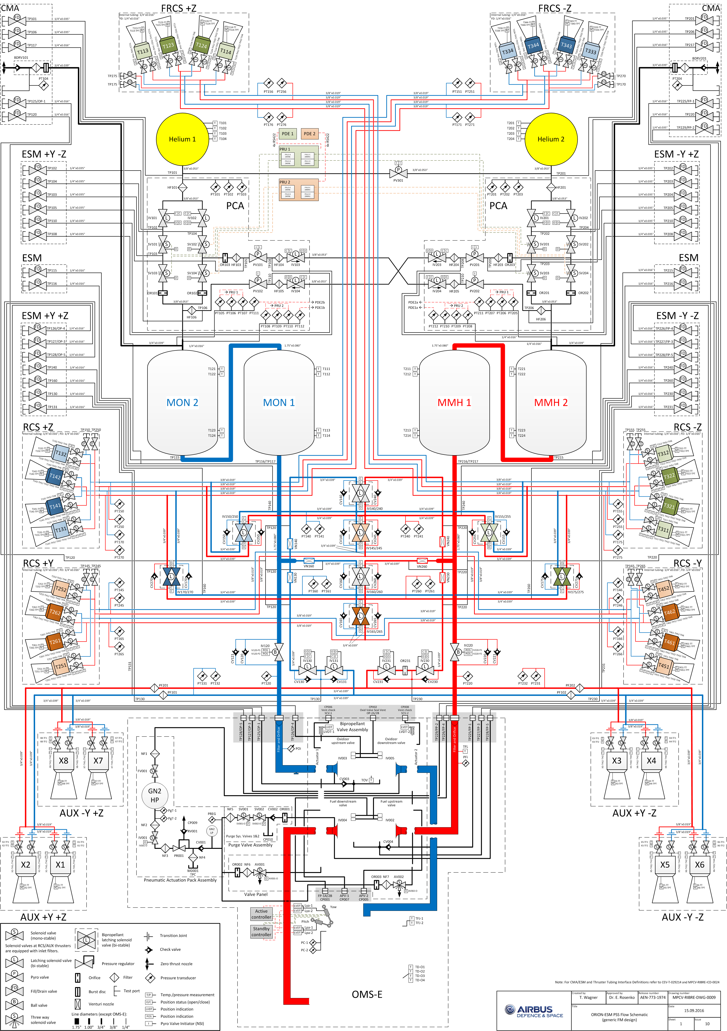
Which Liquid Bi-propellant Propulsion Systems exist?
Objective: To develop the basics of chemical L/L combustion bi-propellant propulsion
Example: Orion-ESM Propulsion System
Human-rated
L4 – Propulsion Systems
Space Propulsion ENG-510

Slide 64
Which Liquid Bi-propellant Propulsion Systems exist?
Objective: To develop the basics of chemical L/L combustion bi-propellant propulsion
Example: A5 Upper Stage EPS Propulsion System
Commercial launch vehicle
L4 – Propulsion Systems
Space Propulsion ENG-510

Slide 65
Which Liquid Bi-propellant Propulsion Systems exist?
Objective: To develop the basics of chemical L/L combustion bi-propellant propulsion
Architecture for Liquid Bi-propellant Combustion Propulsion Systems :
Liquid propellant must be stored in separate tanks (e.g. cylindrical tanks, spherical tanks, torus tanks, spherical + conical tanks, …)
It allows to operate all Equipment below the regulator at lower pressure and therefore has lower strength requirements
It allows to operate the thruster at constant inlet pressure until the storage tank pressure drops below the regulator pressure and therefore ensures consistent level of thrust
L4 – Propulsion Systems
Space Propulsion ENG-510

Slide 66
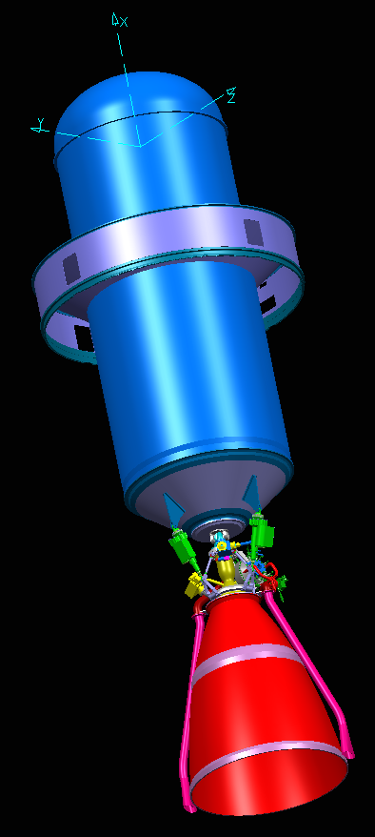
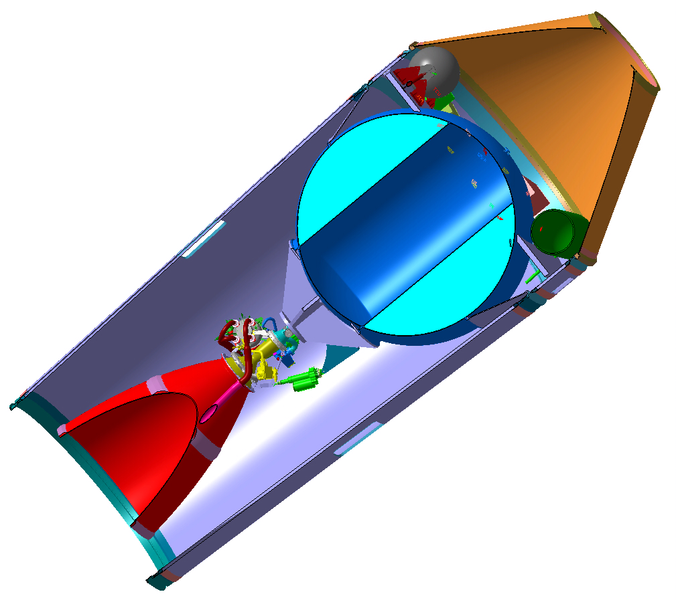
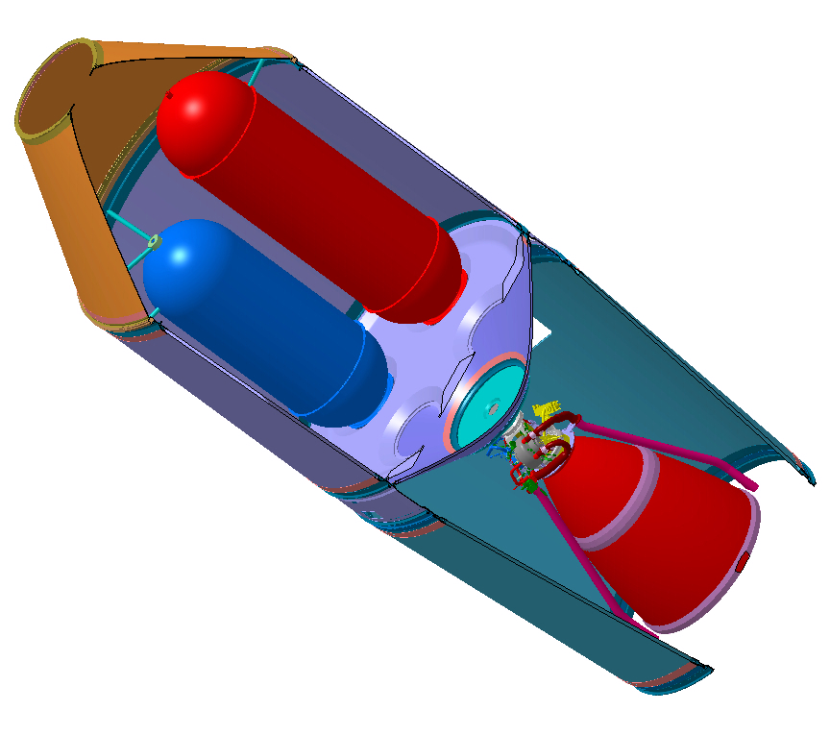
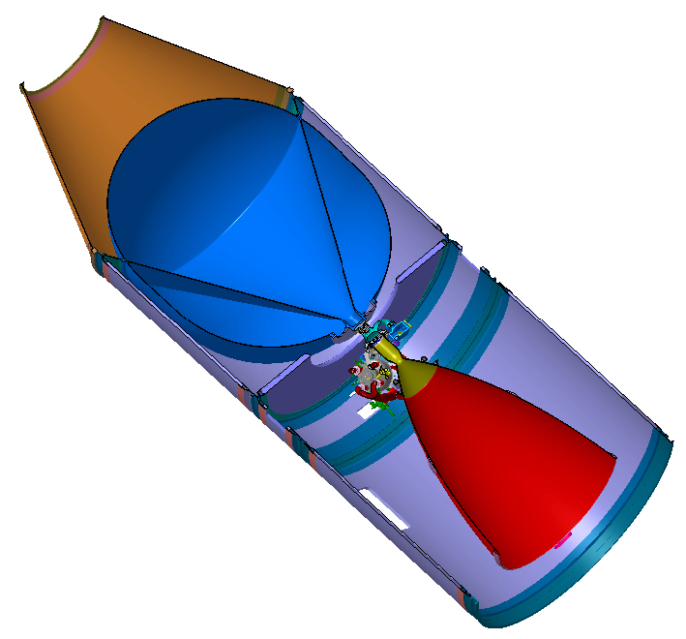
Which Liquid Bi-propellant Propulsion Systems exist?
Objective: To develop the basics of chemical L/L combustion bi-propellant propulsion
L4 – Propulsion Systems
Space Propulsion ENG-510

Slide 67
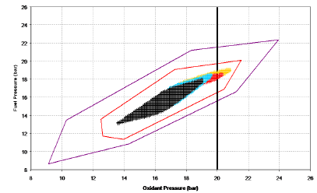
Which Liquid Bi-propellant Propulsion Systems exist?
Objective: To develop the basics of chemical L/L combustion bi-propellant propulsion
Characteristics (disadvantages) of a Bi-propellant Propulsion System
Lower density than solid propellants
Higher parts count than other chemical systems
High complexity
Concerns on leakage
Concerns on combustion stability
Difficult to control flow
Need mixture ratio control
Need special design for zero-g ignition
L4 – Propulsion Systems
Space Propulsion ENG-510

Slide 68
Which Liquid Bi-propellant Propulsion Systems exist?
Objective: To develop the basics of chemical L/L combustion bi-propellant propulsion
Characteristics (advantages) of a Bi-propellant Propulsion System
Highest achievable specific impulse for chemical rocket propulsion
Controllability (on / off control, restart ability, throttable, pulse mode firing which results in important engine parameter for reaction control thruster – minimum impulse bit)
Easy adaptation to launcher or S/C architecture
Possibility of realistic ground testing and pre-launch check-out
Enable component redundancy to virtually any level
L4 – Propulsion Systems
Space Propulsion ENG-510

Slide 69
Which Liquid Bi-propellant Propulsion Systems exist?
Objective: To develop the basics of chemical L/L combustion bi-propellant propulsion
Additional classification of liquid bi-prop systems:
Cryogenic or storable propellants (higher performance but also need for thermal insulation)
Hypergolic or non-hypergolic (dedicated ignitor needed versus risk of hard start)
Toxic or non-toxic (similar to mono-propellant…)
Pressure-fed or pump-fed (pressure-fed similar to mono-prop versus higher performance by pump-fed)
L4 – Propulsion Systems
Space Propulsion ENG-510

Slide 70
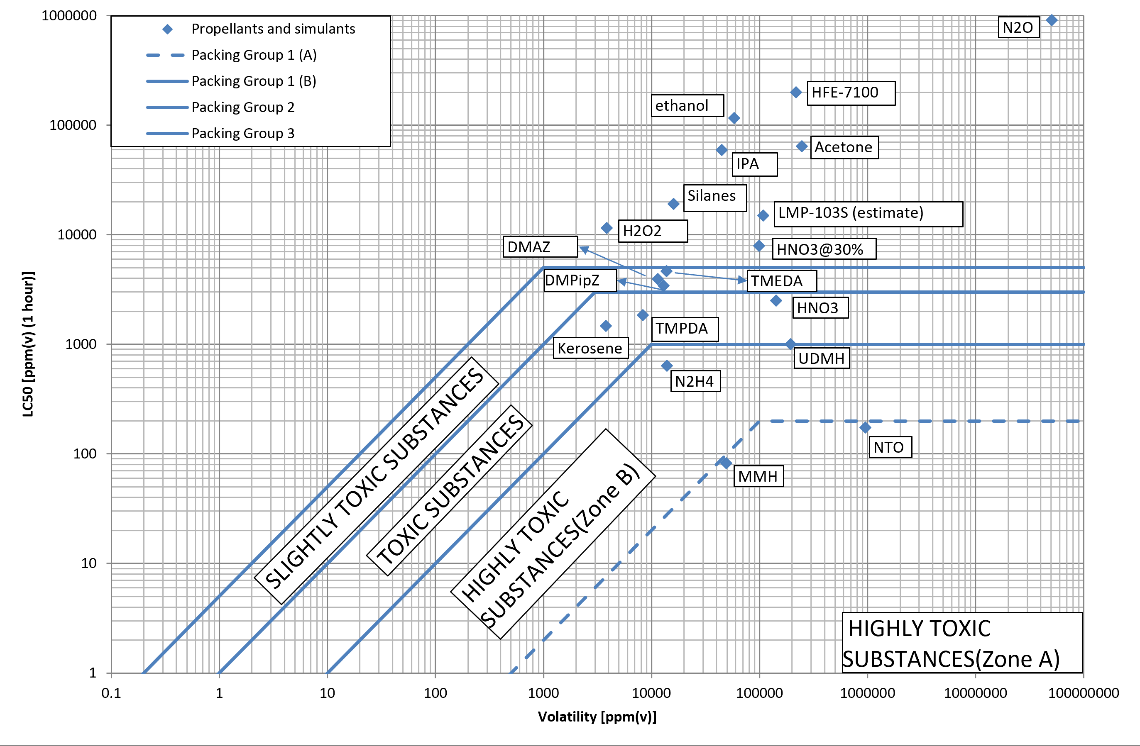
Which Liquid Bi-propellant Propulsion Systems exist?
Objective: To develop the basics of chemical L/L combustion bi-propellant propulsion
a
L4 – Propulsion Systems
Space Propulsion ENG-510

Slide 71
Which Liquid Bi-propellant Propulsion Systems exist?
Objective: To develop the basics of chemical L/L combustion bi-propellant propulsion
Toxic or non-toxic (similar to mono-propellant…)
Conventional Bipropellant are:
Fuel: Monomethyl Hydrazine MMH
Oxidiser: (Di)Nitrogen Tetroxide NTO
L4 – Propulsion Systems
Space Propulsion ENG-510

Slide 72
Which Liquid Bi-propellant Propulsion Systems exist?
Objective: To develop the basics of chemical L/L combustion bi-propellant propulsion
Toxic or non-toxic (similar to mono-propellant…)
Mono-methyl Hydrazine, MMH (CH3NHNH2) Characteristics:
Mono methyl hydrazine is a clear, water-white, hydroscopic, toxic
Stable chemical, can be stored for long periods of time
MMH is not sensitive to shock or friction and is more stable than hydrazine under conditions of mild heating
MMH is very reactive and will undergo a wide variety of reactions with both organic and inorganic compounds.
L4 – Propulsion Systems
Space Propulsion ENG-510

Slide 73
Which Liquid Bi-propellant Propulsion Systems exist?
Objective: To develop the basics of chemical L/L combustion bi-propellant propulsion
Toxic or non-toxic (similar to mono-propellant…)
Nitrogen Tetroxide (N2O4) Characteristics:
Nitrogen tetroxide, also known as dinitrogen tetroxide, is a red/brown liquid
Highly reactive, very toxic oxidiser which is thermally stable and insensitive to mechanical shock and impact
Non-flammable but will support combustion and react hypergolically with high energy fuels
Boiling point = 21°C at atmospheric pressure
Freezing point = -13 °C (MON-3)
L4 – Propulsion Systems
Space Propulsion ENG-510

Slide 74
Which Liquid Bi-propellant Propulsion Systems exist?
Objective: To develop the basics of chemical L/L combustion bi-propellant propulsion
Toxic or non-toxic (similar to mono-propellant…)
Nitrogen Tetroxide (N2O4) Characteristics:
Density ~ 1.44 kg / litre at 20 °C (MON-3)
Irritating, unpleasant odour, similar to bad eggs
Nitrogen Tetroxide is a hazardous chemical!
Air / vapour mixtures can be flammable
Will not burn by itself, but will support combustion of other chemicals
Protective clothing and breathing apparatus must be worn whilst handling
L4 – Propulsion Systems
Space Propulsion ENG-510

Slide 75
Which Liquid Bi-propellant Propulsion Systems exist?
Objective: To develop the basics of chemical L/L combustion bi-propellant propulsion
Toxic or non-toxic (similar to mono-propellant…)
Mixed Oxides of Nitrogen, MON (today in propulsion applications, Nitrogen Tetroxide is mixed with Nitric Oxide gas, NO) (not to be confused with Nitrous Oxide or Nitric Acid)
When NO is in solution the resultant chemical mixture is called Mixed Oxides of Nitrogen or MON
Written as MON-i, where i indicates the percentage NO (volume)
1 % NO content = MON-1 –most used with UDMH fuel
3 % NO content = MON-3 –most used with N2H4 and MMH
L4 – Propulsion Systems
Space Propulsion ENG-510

Slide 76
Which Liquid Bi-propellant Propulsion Systems exist?
Objective: To develop the basics of chemical L/L combustion bi-propellant propulsion
Toxic or non-toxic (similar to mono-propellant…)
NO addition slightly decreases oxidation potential, and makes it more expensive
Corrosiveness is decreased however, particularly in contact with titanium alloys
Addition of NO turns the NTO from red / brown to clear green!
L4 – Propulsion Systems
Space Propulsion ENG-510

Slide 77
Which Liquid Bi-propellant Propulsion Systems exist?
Objective: To develop the basics of chemical L/L combustion bi-propellant propulsion
Architecture for Liquid Bi-propellant Combustion Propulsion Systems:
Propellant feeding cold be performed as pressure-fed or pump-fed system
Pressure-fed is either self-pressurized or with inert gas support
Pressure-fed with inert gas could be either in blow-down modus or pressure-regulated
Pump-fed could be performed with turbopump or e-pump
L4 – Propulsion Systems
Space Propulsion ENG-510

Slide 78
Which Liquid Bi-propellant Propulsion Systems exist?
Objective: To develop the basics of chemical L/L combustion bi-propellant propulsion
Pressure-fed system is feeding liquid propellant to the Combustion Chamber by large pressure difference (>> 20 bar in propellant tank versus vacuum in combustion chamber)
Blow-down system
High pressure (gaseous) storage system in pressurant vessels
Low pressure (solid powder) storage on ground ignited in orbit
Self-pressurization
L4 – Propulsion Systems
Space Propulsion ENG-510

Slide 79
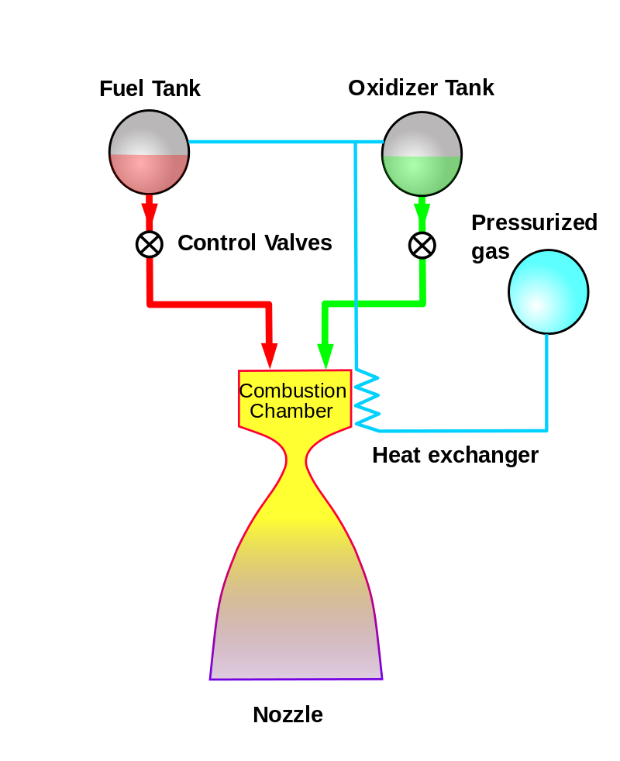
Which Liquid Bi-propellant Propulsion Systems exist?
Objective: To develop the basics of chemical L/L combustion bi-propellant propulsion
Pressure-fed cycle
L4 – Propulsion Systems
Space Propulsion ENG-510

Slide 80
Which Liquid Bi-propellant Propulsion Systems exist?
Objective: To develop the basics of chemical L/L combustion bi-propellant propulsion
Pressure-fed system
The pressure-fed engine / propulsion system is a class of rocket engine designs
A separate gas supply, usually Helium or Nitrogen pressurizes the propellant tanks to force fuel and oxidizer to the combustion chamber
To maintain adequate flow, the tank pressures must exceed the combustion chamber pressure
Pressure fed engines have simple plumbing and have no need for complex and occasionally unreliable turbopumps
L4 – Propulsion Systems
Space Propulsion ENG-510

Slide 81
Which Liquid Bi-propellant Propulsion Systems exist?
Objective: To develop the basics of chemical L/L combustion bi-propellant propulsion
Pressure-fed system
A typical startup procedure begins with opening a valve, often a one-shot pyrotechnic device, to allow the pressurizing gas to flow through check valves into the propellant tanks
Then the propellant valves in the engine itself are opened
If the fuel and oxidizer are hypergolic, they burn on contact; non-hypergolic fuels require an igniter
Multiple burns can be conducted by merely opening and closing the propellant valves as needed, if the pressurization system also has activating valves
L4 – Propulsion Systems
Space Propulsion ENG-510

Slide 82
Which Liquid Bi-propellant Propulsion Systems exist?
Objective: To develop the basics of chemical L/L combustion bi-propellant propulsion
Pressure-fed system
They can be operated electrically, or by gas pressure controlled by smaller electrically operated valves.
Care must be taken, especially during long burns, to avoid excessive cooling of the pressurizing gas due to adiabatic expansion
Cold gas could freeze a propellant, decrease tank pressures or damage components not designed for low temperatures
Pressure-fed engines have practical limits on propellant pressure, which in turn limits combustion chamber pressure
High pressure propellant tanks require thicker walls leading to higher mass
L4 – Propulsion Systems
Space Propulsion ENG-510

Slide 83
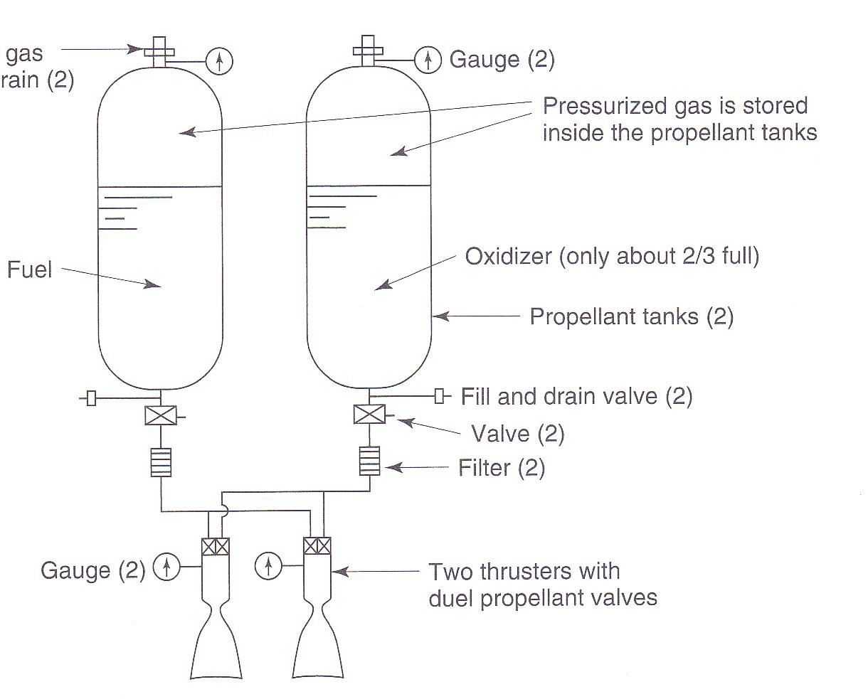
Which Liquid Bi-propellant Propulsion Systems exist?
Objective: To develop the basics of chemical L/L combustion bi-propellant propulsion
Blow-down pressure-fed system
L4 – Propulsion Systems
Space Propulsion ENG-510

Slide 84
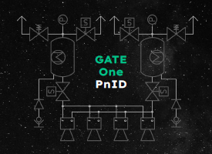
Which Liquid Bi-propellant Propulsion Systems exist?
Objective: To develop the basics of chemical L/L combustion bi-propellant propulsion
Self-pressurized pressure-fed system
Self-pressurized pressure-fed system leads to higher propellant tank structural mass
But not dedicated pressurization system is needed
Vaporization need limits use for long duration burns
Example: Gate Space with NOx / Ethane
L4 – Propulsion Systems
Space Propulsion ENG-510

Slide 85
Which Liquid Bi-propellant Propulsion Systems exist?
Objective: To develop the basics of chemical L/L combustion bi-propellant propulsion
Self-pressurized pressure-fed system
Hydrogen Peroxide / Fuel (Octane, Ethanol, …)
Effect of self decomposition
Compatibility aspects
Nitrous Oxide / Ethane
Self-pressurization
High tank pressure, tank mass
L4 – Propulsion Systems
Space Propulsion ENG-510

Slide 86
Which Liquid Bi-propellant Propulsion Systems exist?
Objective: To develop the basics of chemical L/L combustion bi-propellant propulsion
Pressure regulated pressure-fed system
Pressure-fed regulated system requiring pressure regulator (Reducing the input pressure of a fluid by passive mechanism)
Pressure-fed regulated system results in constant propellant tank pressure = constant flow rate = constant reaction = constant thrust
Only gas tank needs high-pressure
But chamber pressure < O/F tank pressure ≪ gas tank pressure
L4 – Propulsion Systems
Space Propulsion ENG-510

Slide 87
Which Liquid Bi-propellant Propulsion Systems exist?
Objective: To develop the basics of chemical L/L combustion bi-propellant propulsion
Pressure regulated pressure-fed system
Mechanical pressure regulator
The mechanical pressure regulator controls the flow of gas into the propellant tanks
The PR will convert a range of high pressures into a constant low pressure (within limits)
The pressure regulator will work automatically based on the inlet pressure
Most types are series redundant (if the primary valve fails, the outlet pressure will rise until the secondary seat takes over)
L4 – Propulsion Systems
Space Propulsion ENG-510

Slide 88
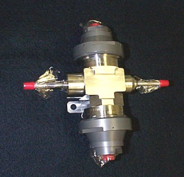
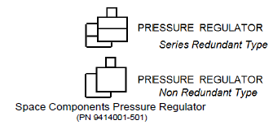
Which Liquid Bi-propellant Propulsion Systems exist?
Objective: To develop the basics of chemical L/L combustion bi-propellant propulsion
Pressure regulated pressure-fed system
Mechanical pressure regulator
L4 – Propulsion Systems
Space Propulsion ENG-510

Slide 89
Which Liquid Bi-propellant Propulsion Systems exist?
Objective: To develop the basics of chemical L/L combustion bi-propellant propulsion
Pressure regulated pressure-fed system
Electro-mechanical pressure regulator
Bang-bang regulation with solenoid valves
L4 – Propulsion Systems
Space Propulsion ENG-510

Slide 90
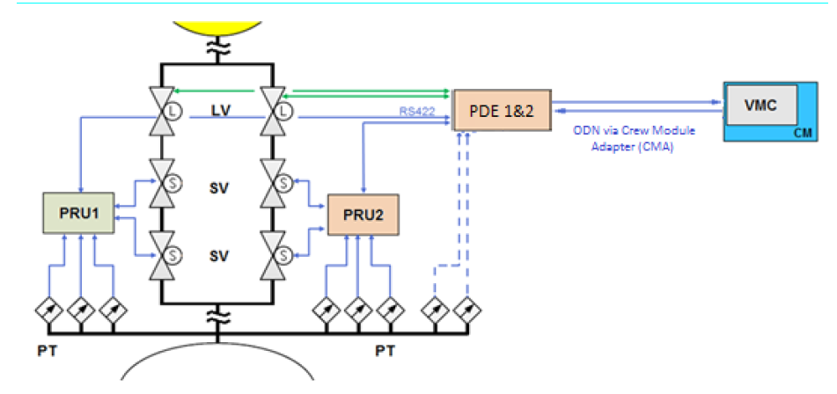
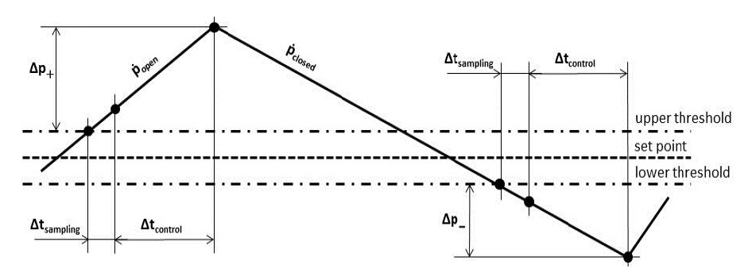
Which Liquid Bi-propellant Propulsion Systems exist?
Objective: To develop the basics of chemical L/L combustion bi-propellant propulsion
Pressure regulated pressure-fed system
Electro-mechanical pressure regulator
Bang-bang regulation with solenoid valves
L4 – Propulsion Systems
Space Propulsion ENG-510

Slide 91
Which Liquid Bi-propellant Propulsion Systems exist?
Objective: To develop the basics of chemical L/L combustion bi-propellant propulsion
Pressure regulated pressure-fed system
Ball valve…
L4 – Propulsion Systems
Space Propulsion ENG-510

Slide 92
Which Liquid Bi-propellant Propulsion Systems exist?
Objective: To develop the basics of chemical L/L combustion bi-propellant propulsion
Pump-fed system:
Pump-fed system is feeding high pressure to the Combustion Chamber resulting in low tank pressure = light weight tank
Today turbo-pumps are mainly used but also more and more electro-pumps are considered
Turbo-pumps are technically very difficult equipment
Electro-pumps require lot of power (i.e. batteries, mass, …)
Note: Cryogenic propellant require a very low tank pressure
L4 – Propulsion Systems
Space Propulsion ENG-510

Slide 93
Which Liquid Bi-propellant Propulsion Systems exist?
Objective: To develop the basics of chemical L/L combustion bi-propellant propulsion
Turbo-pumps architecture
Gas generator cycle
Combustion tap-off cycle
Expander-bleed cycle (single or dual expander cycle)
Full expander cycle
Staged combustion cycle (fuel-rich, Ox-rich, full flow)
Electro-pumps architecture
L4 – Propulsion Systems
Space Propulsion ENG-510

Slide 94
Which Liquid Bi-propellant Propulsion Systems exist?
Objective: To develop the basics of chemical L/L combustion bi-propellant propulsion
Turbo-pumps architecture
L4 – Propulsion Systems
Engine Cycle | Open Cycle (Dump Gas) | Closed Loop (Re-use Gas)
Burner | Gas Generator Combustion Tap-off | Staged Combustion
Regenerative cooling | Expander-bleed | Full expander
Space Propulsion ENG-510

Slide 95
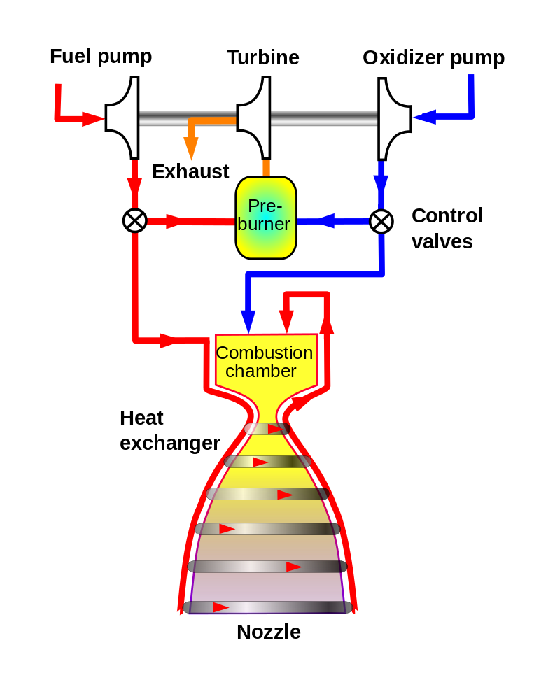
Which Liquid Bi-propellant Propulsion Systems exist?
Gas Generator Cycle
Objective: To develop the basics of chemical L/L combustion bi-propellant propulsion
a
L4 – Propulsion Systems
Space Propulsion ENG-510
Gas-generator rocket cycle - Some of the fuel and oxidizer is burned separately to power the pumps and then discarded
Most gas-generator engines use the fuel for nozzle cooling
Burner dedicated for the turbine

Slide 96
Which Liquid Bi-propellant Propulsion Systems exist?
Objective: To develop the basics of chemical L/L combustion bi-propellant propulsion
Pump-fed gas-generator cycle:
The gas-generator cycle is a power cycle of a pumped liquid bi-propellant engine
Part of the unburned propellant is burned in a gas generator (or pre-burner) and the resulting hot gas is used to power the propellant pumps before being exhausted overboard and lost
Because of this loss, this type of engine is termed open cycle
L4 – Propulsion Systems
Space Propulsion ENG-510

Slide 97
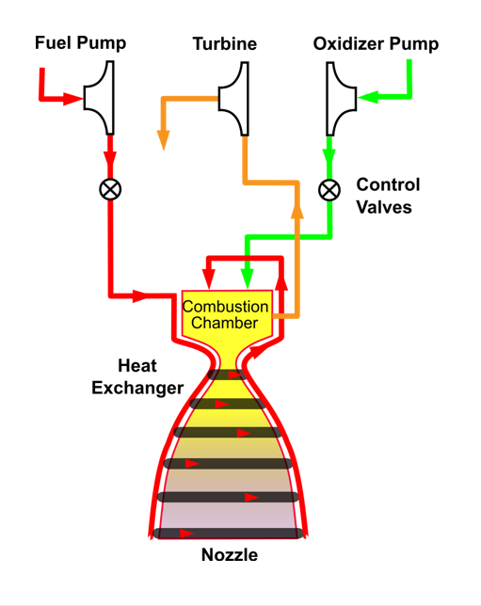
Which Liquid Bi-propellant Propulsion Systems exist?
Combustion Tap-off Cycle
Objective: To develop the basics of chemical L/L combustion bi-propellant propulsion
a
L4 – Propulsion Systems
Space Propulsion ENG-510
Combustion tap-off cycle - Diagram of the open-cycle combustion tap-off rocket cycle
A small portion of exhaust from the combustion chamber is tapped off to power the turbine(s)

Slide 98
Which Liquid Bi-propellant Propulsion Systems exist?
Objective: To develop the basics of chemical L/L combustion bi-propellant propulsion
Pump-fed combustion tap-off cycle:
The combustion tap-off cycle is a power cycle of a bi-propellant engine
The cycle takes a small portion of hot exhaust gas from the combustion chamber and routes it through the turbo-pump turbines to pump fuel before being exhausted (similar to the gas generator cycle)
Since fuel is exhausted, the tap-off cycle is considered an open-cycle engine. The cycle is comparable to a gas-generator cycle engine with turbines driven by main combustion chamber exhaust rather than a separate gas generator or pre-burner
L4 – Propulsion Systems
Space Propulsion ENG-510

Slide 99
Which Liquid Bi-propellant Propulsion Systems exist?
Objective: To develop the basics of chemical L/L combustion bi-propellant propulsion
Pump-fed combustion tap-off cycle:
Example: Blue Origin BE-3 engine
The cycle is simple with only one combustion chamber and a less stressful engine shutdown process
However, engine startup is more complicated and due to the hot gas fed from the main combustion chamber into the turbopumps, the turbine must be built to withstand higher-than-normal temperatures
L4 – Propulsion Systems
Space Propulsion ENG-510

Slide 100
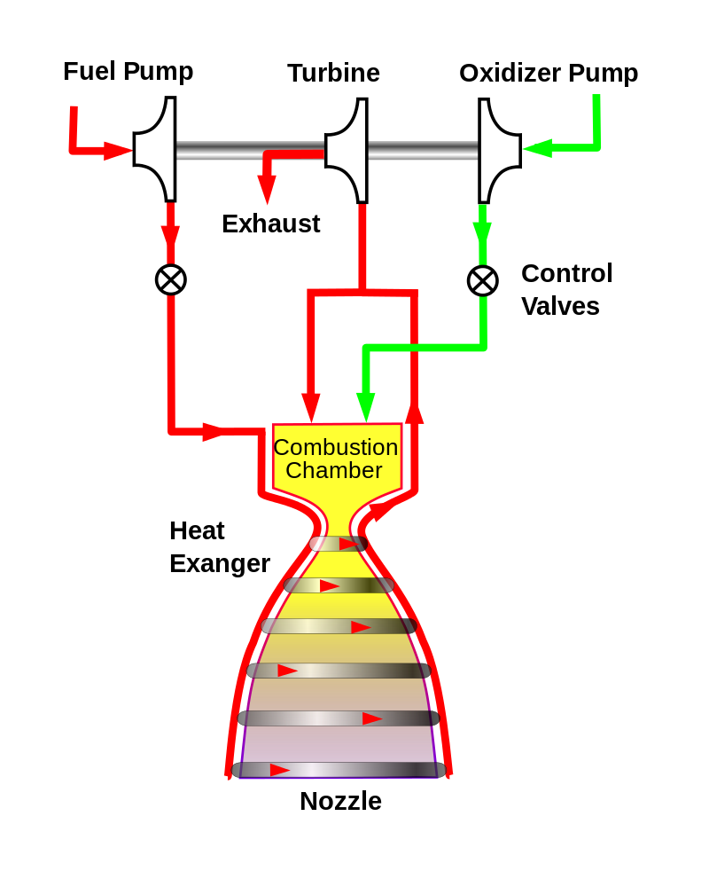
Which Liquid Bi-propellant Propulsion Systems exist?
Expander-bleed Cycle
Objective: To develop the basics of chemical L/L combustion bi-propellant propulsion
a
L4 – Propulsion Systems
Space Propulsion ENG-510
Expander-bleed Cycle - Expander open cycle
(Also named coolant tap-off)
Bleed a part of expanded (coolant) gas

Slide 101
Which Liquid Bi-propellant Propulsion Systems exist?
Objective: To develop the basics of chemical L/L combustion bi-propellant propulsion
Pump-fed expander-bleed cycle:
The expander-bleed cycle is a modification of the traditional expander cycle
In the bleed (or open) cycle, instead of routing all of the heated propellant through the turbine and sending it back to be combusted, only a small portion of the heated propellant is used to drive the turbine and is then vented overboard without going through the combustion chamber
The other portion is injected into the combustion chamber
Bleeding off the turbine exhaust allows for a higher turbopump efficiency by decreasing back-pressure and maximizing the pressure drop through the turbine
L4 – Propulsion Systems
Space Propulsion ENG-510

Slide 102
Which Liquid Bi-propellant Propulsion Systems exist?
Objective: To develop the basics of chemical L/L combustion bi-propellant propulsion
Pump-fed expander-bleed cycle:
Compared with a standard expander cycle, this allows higher engine thrust at the cost of efficiency by dumping the turbine exhaust
Example: Mitsubishi LE-5A engine was the world's first expander bleed cycle engine to be put into operational service
L4 – Propulsion Systems
Space Propulsion ENG-510

Slide 103
Which Liquid Bi-propellant Propulsion Systems exist?
Objective: To develop the basics of chemical L/L combustion bi-propellant propulsion
Pump-fed dual expander cycle:
In a similar way that the staged combustion cycle can be implemented separately on the oxidizer and fuel on the full flow cycle, the expander cycle can be implemented on two separate paths as the dual expander cycle
The use of hot gases of the same chemistry as the liquid for the turbine and pump side of the turbopumps eliminates the need for purges and some failure modes
Additionally, when the density of the fuel and oxidizer is significantly different, as it is in the LH2 / LOx case, the optimal turbopump speeds differ so much that they need a gearbox between the fuel and oxidizer pumps
L4 – Propulsion Systems
Space Propulsion ENG-510

Slide 104
Which Liquid Bi-propellant Propulsion Systems exist?
Objective: To develop the basics of chemical L/L combustion bi-propellant propulsion
Pump-fed dual expander cycle:
The use of dual expander cycle, with separate turbines, eliminates this failure-prone piece of equipment (i.e. gear box)
Dual expander cycle can be implemented by either using separated sections on the regenerative cooling system for the fuel and the oxidizer, or by using a single fluid for cooling and a heat exchanger to boil the second fluid
In the first case, for example, you could use the fuel to cool the combustion chamber, and the oxidizer to cool the nozzle extension
In the second case, you could use the fuel to cool the whole engine and a heat exchanger to boil the oxidizer
L4 – Propulsion Systems
Space Propulsion ENG-510

Slide 105

Which Liquid Bi-propellant Propulsion Systems exist?
Full Expander Cycle
Objective: To develop the basics of chemical L/L combustion bi-propellant propulsion
a
L4 – Propulsion Systems
Space Propulsion ENG-510
Expander rocket engine (closed cycle) - Heat from the nozzle and combustion chamber powers the fuel and oxidizer pump
Use of expanded (coolant) gas

Slide 106
Which Liquid Bi-propellant Propulsion Systems exist?
Objective: To develop the basics of chemical L/L combustion bi-propellant propulsion
Pump-fed full expander cycle:
The full expander cycle is a power cycle of a bi-propellant engine
In this cycle, the fuel is used to cool the engine's combustion chamber, picking up heat and changing phase
The now heated and gaseous fuel then powers the turbine that drives the engine's fuel and oxidizer pumps before being injected into the combustion chamber and burned
Because of the necessary phase change, the expander cycle is thrust limited by the square-cube law
When a bell-shaped nozzle is scaled, the nozzle surface area with which to heat the fuel increases as the square of the radius, but the volume of fuel to be heated increases as the cube of the radius
L4 – Propulsion Systems
Space Propulsion ENG-510

Slide 107
Which Liquid Bi-propellant Propulsion Systems exist?
Objective: To develop the basics of chemical L/L combustion bi-propellant propulsion
Pump-fed full expander cycle:
So, beyond approximately 300 kN of thrust, there is no longer enough nozzle area to heat enough fuel to drive the turbines and hence the fuel pumps
Higher thrust levels can be achieved using a bypass expander cycle where a portion of the fuel bypasses the turbine and or thrust chamber cooling passages and goes directly to the main chamber injector
L4 – Propulsion Systems
Space Propulsion ENG-510

Slide 108
Which Liquid Bi-propellant Propulsion Systems exist?
Objective: To develop the basics of chemical L/L combustion bi-propellant propulsion
Pump-fed full expander cycle:
All expander cycle engines need to use cryogenic propellant such as liquid Hydrogen, liquid Methane or liquid Propane that easily reaches its boiling point
Some expander cycle engines may use a gas generator of some kind to start the turbine and run the engine until the heat input from the thrust chamber and nozzle skirt increases as the chamber pressure builds up
An example of an expander cycle engine is the Vinci engine for the Ariane 6 launch vehicle
L4 – Propulsion Systems
Space Propulsion ENG-510

Slide 109
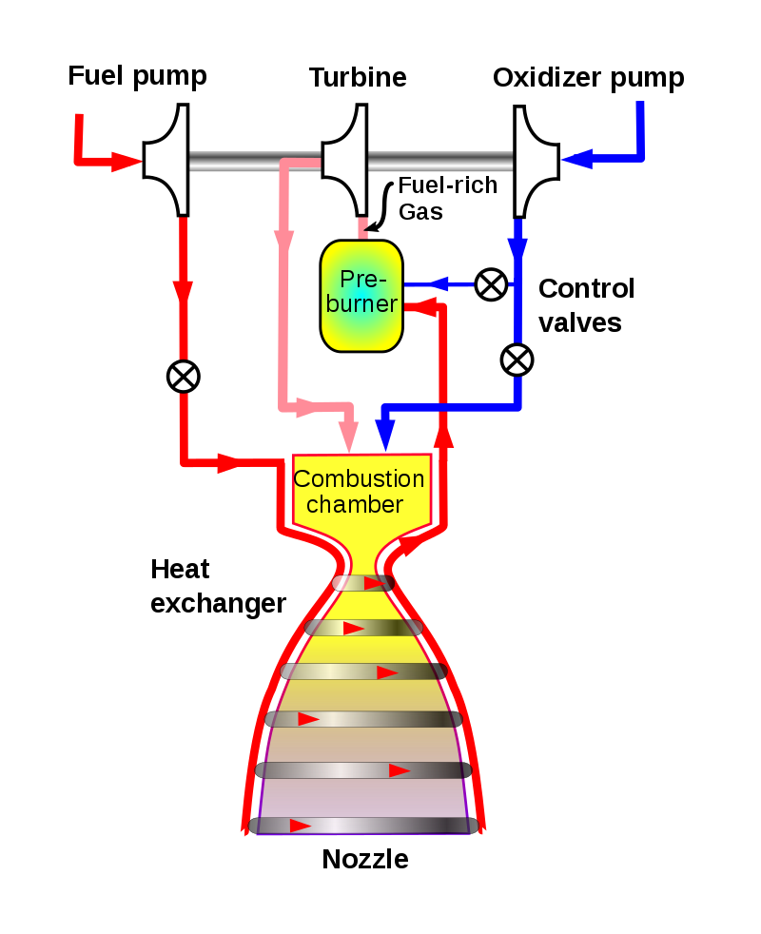
Which Liquid Bi-propellant Propulsion Systems exist?
Staged Combustion Cycle – Fuel Rich
Objective: To develop the basics of chemical L/L combustion bi-propellant propulsion
a
L4 – Propulsion Systems
Space Propulsion ENG-510
Pre-burner system with 2 chambers

Slide 110
Which Liquid Bi-propellant Propulsion Systems exist?
Objective: To develop the basics of chemical L/L combustion bi-propellant propulsion
Pump-fed staged combustion cycle:
The staged combustion cycle (sometimes known as topping cycle, pre-burner cycle, or closed cycle) is a power cycle of a bi-propellant engine
In the staged combustion cycle, propellant flows through multiple combustion chambers and is thus combusted in stages
The main advantage relative to other rocket engine power cycles is the high fuel efficiency measured through the specific impulse, while its main disadvantage is its complexity
L4 – Propulsion Systems
Space Propulsion ENG-510

Slide 111
Which Liquid Bi-propellant Propulsion Systems exist?
Objective: To develop the basics of chemical L/L combustion bi-propellant propulsion
Pump-fed staged combustion cycle:
Typically, propellant flows through two kinds of combustion chambers: the first called pre-burner and the second called main combustion chamber
In the pre-burner, a small portion of propellant, usually fuel-rich, is partly combusted, and the increasing volume flow is used to drive the turbo-pumps that feed the engine with propellant
The gas impulse, is then injected into the main combustion chamber and combusted completely with the other propellant to produce thrust
L4 – Propulsion Systems
Space Propulsion ENG-510

Slide 112
Which Liquid Bi-propellant Propulsion Systems exist?
Objective: To develop the basics of chemical L/L combustion bi-propellant propulsion
Pump-fed staged combustion cycle:
The main advantage is fuel efficiency due to all of the propellant flowing to the main combustion chamber, which also allows for higher thrust
The staged combustion cycle is sometimes referred to as closed cycle, as opposed to the gas generator cycle or open cycle where a portion of propellant never reaches the main combustion chamber, here the full flow passes the main combustion chamber
The disadvantage is its complexity, partly a result of the pre-burner exhaust of hot and highly pressurized gas which, particularly when oxidizer-rich, produces extremely harsh conditions for turbines and plumbing
L4 – Propulsion Systems
Space Propulsion ENG-510

Slide 113
Which Liquid Bi-propellant Propulsion Systems exist?
Objective: To develop the basics of chemical L/L combustion bi-propellant propulsion
Pump-fed staged combustion cycle:
Several variants of the staged combustion cycle exist
Pre-burners that burn a small portion of oxidizer with a full flow of fuel are called fuel-rich, while pre-burners that burn a small portion of fuel with a full flow of oxidizer are called oxidizer-rich
When both oxidizer-rich and fuel-rich pre-burners are used on a single engine, the cycle is called full-flow staged combustion.
Staged combustion designs can be either single-shaft or twin-shaft.
In the single-shaft design, one set of pre-burner and turbine drives both propellant turbo-pumps
L4 – Propulsion Systems
Space Propulsion ENG-510

Slide 114
Which Liquid Bi-propellant Propulsion Systems exist?
Objective: To develop the basics of chemical L/L combustion bi-propellant propulsion
Pump-fed staged combustion cycle:
In the twin-shaft design, the two propellant turbopumps are driven by separate turbines, which are in turn driven by the outflow of either one or separate pre-burners
Relative to a single-shaft design, the twin-shaft design requires an additional turbine (and possibly another pre-burner) but allows for individual control of the two turbo-pumps
In addition to the propellant turbopumps, staged combustion engines often require smaller boost pumps to prevent both pre-burner back-flow and turbo-pump cavitation
L4 – Propulsion Systems
Space Propulsion ENG-510

Slide 115
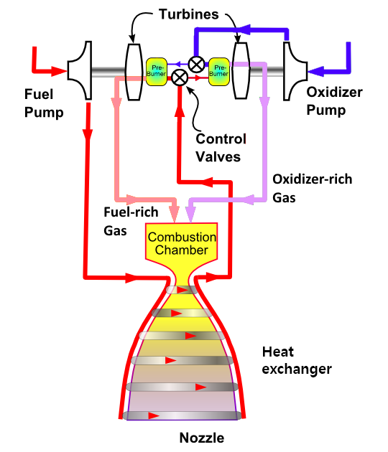
Which Liquid Bi-propellant Propulsion Systems exist?
Stage Combustion Cycle – Full Flow
Objective: To develop the basics of chemical L/L combustion bi-propellant propulsion
a
L4 – Propulsion Systems
Space Propulsion ENG-510
Pre-burner system with 2 chambers

Slide 116
Which Liquid Bi-propellant Propulsion Systems exist?
Objective: To develop the basics of chemical L/L combustion bi-propellant propulsion
Pump-fed full flow staged combustion cycle:
Full-flow staged combustion (FFSC) is a twin-shaft staged combustion cycle that uses both oxidizer-rich and fuel-rich pre-burners
The cycle allows full flow of both propellants through the turbines
The fuel turbo-pump is driven by the fuel-rich pre-burner, and the oxidizer turbo-pump is driven by the oxidizer-rich pre-burner
Benefits of the full-flow staged combustion cycle include turbines that run cooler and at lower pressure, due to increased mass flow, leading to a longer engine life and higher reliability
L4 – Propulsion Systems
Space Propulsion ENG-510

Slide 117
Which Liquid Bi-propellant Propulsion Systems exist?
Objective: To develop the basics of chemical L/L combustion bi-propellant propulsion
Pump-fed full flow staged combustion cycle:
Further, the full-flow cycle eliminates the need for an inter-propellant turbine seal normally required to separate oxidizer-rich gas from the fuel turbopump or fuel-rich gas from the oxidizer turbo-pump, thus improving reliability
Since the use of both fuel and oxidizer pre-burners results in full gasification of each propellant before entering the main combustion chamber, faster chemical reactions are given in the combustion chamber, allowing a smaller combustion chamber
L4 – Propulsion Systems
Space Propulsion ENG-510

Slide 118
Which Liquid Bi-propellant Propulsion Systems exist?
Objective: To develop the basics of chemical L/L combustion bi-propellant propulsion
Pump-fed full flow staged combustion cycle:
This in turn makes it feasible to increase the chamber pressure, which increases efficiency
Potential disadvantages of the full-flow staged combustion cycle include increased engineering complexity of two pre-burners, relative to a single-shaft staged combustion cycle, as well as an increased parts count
L4 – Propulsion Systems
Space Propulsion ENG-510

Slide 119
Which Liquid Bi-propellant Propulsion Systems exist?
Objective: To develop the basics of chemical L/L combustion bi-propellant propulsion
a
L4 – Propulsion Systems
Space Propulsion ENG-510

Slide 120
Which Liquid Bi-propellant Propulsion Systems exist?
Objective: To develop the basics of chemical L/L combustion bi-propellant propulsion
But one could also use an electric pump…
L4 – Propulsion Systems
Space Propulsion ENG-510

Slide 121
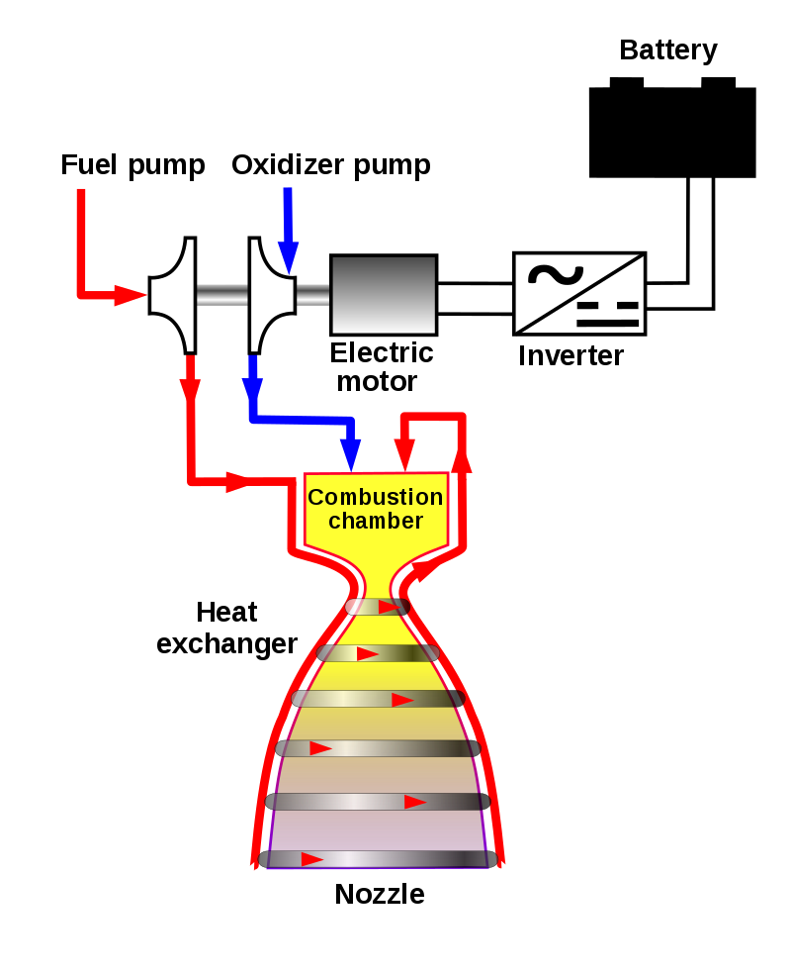
Which Liquid Bi-propellant Propulsion Systems exist?
Electric-pump Cycle
Objective: To develop the basics of chemical L/L combustion bi-propellant propulsion
a
Electric-feed rocket cycle – The oxidizer and fuel are fed to the pump which increases the pressure before injecting it into the combustion chamber. The pumps are actuated by an electric motor powered by batteries. An inverter converts the batteries' DC electricity to the AC needed by the motor. The fuel is also circulated around the outside of the combustion chamber and nozzle to prevent it from overheating
L4 – Propulsion Systems
Space Propulsion ENG-510

Slide 122
Which Liquid Bi-propellant Propulsion Systems exist?
Objective: To develop the basics of chemical L/L combustion bi-propellant propulsion
Electric pump-fed system:
The electric pump-fed engine is a bi-propellant engine cycle in which the fuel pumps are electrically powered, and so all of the input propellant is directly burned in the main combustion chamber, and none is diverted to drive the pumps
This differs from traditional engine cycles, in which the pumps are driven by a portion of the input propellants.
An electric cycle engine uses electric pumps to pressurize the propellants from a low-pressure fuel tank to high-pressure combustion chamber level
L4 – Propulsion Systems
Space Propulsion ENG-510

Slide 123
Which Liquid Bi-propellant Propulsion Systems exist?
Objective: To develop the basics of chemical L/L combustion bi-propellant propulsion
Electric pump-fed system:
The pumps are powered by an electric motor with electricity from a battery bank
Example: Rutherford engine from the Electron launch vehicle from Rocketlab
In comparison to turbo-pumped rocket cycles such, an electric cycle engine has potentially worse performance due to the added mass of the batteries but may have lower development and manufacturing costs due its mechanical simplicity, its lack of high temperature turbomachinery, and its easier controllability
L4 – Propulsion Systems
Space Propulsion ENG-510

Slide 124
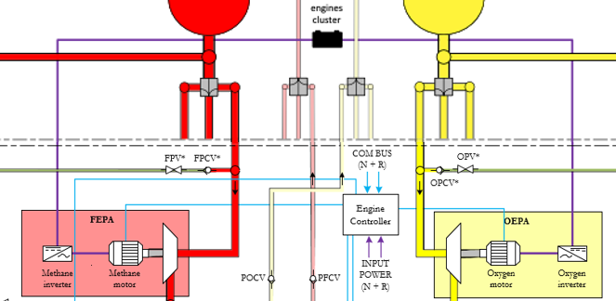
Which Liquid Bi-propellant Propulsion Systems exist?
Objective: To develop the basics of chemical L/L combustion bi-propellant propulsion
Electric pump-fed system:
Example: Huracan engine from The Exploration Company
L4 – Propulsion Systems
Space Propulsion ENG-510

Slide 125
Which Liquid Bi-propellant Propulsion Systems exist?
Objective: To develop the basics of chemical L/L combustion bi-propellant propulsion
Pressure Vessels Types (including vessels for pressurant gas storage but also propellant storage)
Type I – Full metal: Cylinder is made entirely from metal
Type II – Hoop wrap: Metal cylinder, reinforced by a belt-like hoop wrap with fibre-reinforced resin
Type III – Fully wrapped, over metal liner: Diagonally wrapped fibres form the load bearing shell on the cylindrical section and at the bottom and shoulder around the metal neck. The metal liner is thin and provides the gas tight barrier
L4 – Propulsion Systems
Space Propulsion ENG-510

Slide 126
Which Liquid Bi-propellant Propulsion Systems exist?
Objective: To develop the basics of chemical L/L combustion bi-propellant propulsion
Pressure Vessels Types (including vessels for pressurant gas storage but also propellant storage)
Type IV – Fully wrapped, over non-metal liner: A lightweight thermoplastic liner provides the gas tight barrier, and the mandrel to wrap fibers and resin matrix around. Only the neck which carries the neck thread and its anchor to the liner is made of metal, which may be lightweight Aluminum or sturdy stainless steel
L4 – Propulsion Systems
Space Propulsion ENG-510

Slide 127
Which Liquid Bi-propellant Propulsion Systems exist?
Objective: To develop the basics of chemical L/L combustion bi-propellant propulsion
Pressure Vessels Types (including vessels for pressurant gas storage but also propellant storage)
Type V - Compared to Type I, II and III tanks using metal, and Type IV tanks using a plastic liner, Type V pressure vessels offer the lightest weight, featuring a fully composite construction reinforced primarily with carbon fiber but without a liner. However, because the liner serves as a barrier to prevent gases and cryogenic liquids from permeating into the composite laminate at high pressures building liner less tanks that can perform reliably for potentially thousands of pressurization cycles is no easy feature
L4 – Propulsion Systems
Space Propulsion ENG-510

Slide 128
Which Liquid Bi-propellant Propulsion Systems exist?
Objective: To develop the basics of chemical L/L combustion bi-propellant propulsion
Pressure Vessels Types (including vessels for pressurant gas storage but also propellant storage)
Polar mounted or equatorial mounted
L4 – Propulsion Systems
Space Propulsion ENG-510

Slide 129
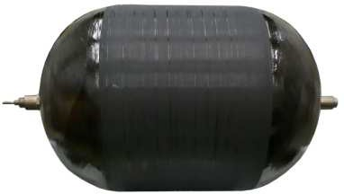
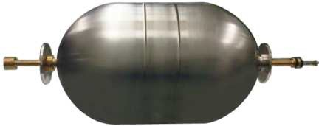
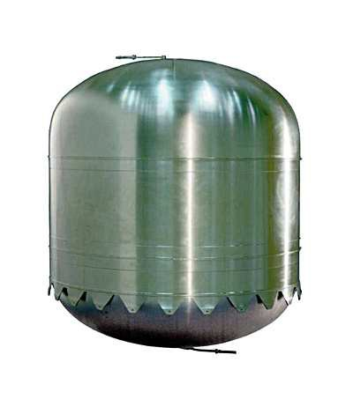


Which Liquid Bi-propellant Propulsion Systems exist?
Objective: To develop the basics of chemical L/L combustion bi-propellant propulsion
Pressure Vessels Types
L4 – Propulsion Systems
Space Propulsion ENG-510

Slide 130
Which Liquid Bi-propellant Propulsion Systems exist?
Objective: To develop the basics of chemical L/L combustion bi-propellant propulsion
Pressure Vessels Considerations
Propellant / pressurant leakage
Leak before burst - Leak before burst describes a pressure vessel designed such that a crack in the vessel will grow through the wall, allowing the contained fluid to escape and reducing the pressure, prior to growing so large as to cause fracture at the operating pressure
Liquid propellant control
L4 – Propulsion Systems
Space Propulsion ENG-510

Slide 131
Which Liquid Bi-propellant Propulsion Systems exist?
Objective: To develop the basics of chemical L/L combustion bi-propellant propulsion
Liquid Propellant Control
Positive Expulsion Device – Bladder, Diaphragm (metallic or plastic)
Surface Tension Device – Capillary forces
Piston Device – Pressure force
Pre-acceleration + Collector – Acceleration forces
Damping – Baffles
Zero-sloshing Tank – De-orbitation for small spacecraft
L4 – Propulsion Systems
Space Propulsion ENG-510

Slide 132
Which Liquid Bi-propellant Propulsion Systems exist?
Objective: To develop the basics of chemical L/L combustion bi-propellant propulsion
Liquid Propellant Control:
Example: Stage separation
L4 – Propulsion Systems
Space Propulsion ENG-510

Slide 133

Which Liquid Bi-propellant Propulsion Systems exist?
Objective: To develop the basics of chemical L/L combustion bi-propellant propulsion
Liquid Propellant Control:
Example: Stage separation
L4 – Propulsion Systems
Space Propulsion ENG-510

Slide 134


Which Liquid Bi-propellant Propulsion Systems exist?
Objective: To develop the basics of chemical L/L combustion bi-propellant propulsion
Liquid Propellant Control
Positive Expulsion Device – Plastic diaphragm
L4 – Propulsion Systems
Space Propulsion ENG-510

Slide 135

Which Liquid Bi-propellant Propulsion Systems exist?
Objective: To develop the basics of chemical L/L combustion bi-propellant propulsion
Liquid Propellant Control
Positive Expulsion Device – Metallic diaphragm
L4 – Propulsion Systems
Space Propulsion ENG-510

Slide 136



Which Liquid Bi-propellant Propulsion Systems exist?
Objective: To develop the basics of chemical L/L combustion bi-propellant propulsion
Liquid Propellant Control
Positive Expulsion Device – Bladder
L4 – Propulsion Systems
Space Propulsion ENG-510

Slide 137



Which Liquid Bi-propellant Propulsion Systems exist?
Objective: To develop the basics of chemical L/L combustion bi-propellant propulsion
Liquid Propellant Control
Surface Tension Device – Capillary forces
L4 – Propulsion Systems
Space Propulsion ENG-510

Slide 138

Which Liquid Bi-propellant Propulsion Systems exist?
Objective: To develop the basics of chemical L/L combustion bi-propellant propulsion
Liquid Propellant Control
Piston Device – Pressure force
L4 – Propulsion Systems
Space Propulsion ENG-510

Slide 139

Which Liquid Bi-propellant Propulsion Systems exist?
Objective: To develop the basics of chemical L/L combustion bi-propellant propulsion
Liquid Propellant Control
Pre-acceleration + Collector (Sponge) – Acceleration forces
L4 – Propulsion Systems
Space Propulsion ENG-510

Slide 140

Which Liquid Bi-propellant Propulsion Systems exist?
Objective: To develop the basics of chemical L/L combustion bi-propellant propulsion
a
L4 – Propulsion Systems
Space Propulsion ENG-510

Slide 141

Which Liquid Bi-propellant Propulsion Systems exist?
Objective: To develop the basics of chemical L/L combustion bi-propellant propulsion
L4 – Propulsion Systems
Space Propulsion ENG-510

Slide 142


Which Liquid Bi-propellant Propulsion Systems exist?
Objective: To develop the basics of chemical L/L combustion bi-propellant propulsion
Liquid Propellant Control
Damping (Sloshing, Vortex) – Baffles
L4 – Propulsion Systems
Space Propulsion ENG-510

Slide 143
Which Liquid Bi-propellant Propulsion Systems exist?
Objective: To develop the basics of chemical L/L combustion bi-propellant propulsion
Liquid Propellant Control
Zero-sloshing Tank – De-orbitation for small spacecraft
Potentially Piston…
Or N2O in supercritical state…
L4 – Propulsion Systems
Space Propulsion ENG-510

Slide 144
Which Liquid Bi-propellant Propulsion Systems exist?
Objective: To develop the basics of chemical L/L combustion bi-propellant propulsion
Valve Functions
Fill & Drain
Isolation
Regulation
Flow control
Throttling
…
L4 – Propulsion Systems
Space Propulsion ENG-510

Slide 145
Which Liquid Bi-propellant Propulsion Systems exist?
Objective: To develop the basics of chemical L/L combustion bi-propellant propulsion
Valve Types
Pyro Valves (N/O – normally open – or N/C – normally closed)
SMA Valves (Shape Memory Alloy)
Check Valves
Monostable Valves (Solenoid valves) – Flow Control Valves
Bistable Valves (Latch valves)
Pneumatic Valves
Electric Valves
L4 – Propulsion Systems
Space Propulsion ENG-510

Slide 146
Which Liquid Bi-propellant Propulsion Systems exist?
Objective: To develop the basics of chemical L/L combustion bi-propellant propulsion
Valve Types
Ball Valves
Fill & Drain Valves
Burst Disk + Relief Valve
L4 – Propulsion Systems
Space Propulsion ENG-510

Slide 147
Which Liquid Bi-propellant Propulsion Systems exist?
Objective: To develop the basics of chemical L/L combustion bi-propellant propulsion
Valve Types
Pyro Valves (N/O – normally open – or N/C – normally closed): Redundancy
PVs are a one shot deal
Explosive charges are fired to open the valve (normally closed type) or to close the valve (normally open type
PVs are used to permanently change the flow paths within the propulsion system
Better leakage rate than latch or solenoid valves
Cost effective
L4 – Propulsion Systems
Space Propulsion ENG-510

Slide 148


Which Liquid Bi-propellant Propulsion Systems exist?
Objective: To develop the basics of chemical L/L combustion bi-propellant propulsion
Valve Types
Pyro Valves (N/O – normally open – or N/C – normally closed): Redundancy
L4 – Propulsion Systems
Space Propulsion ENG-510

Slide 149

Which Liquid Bi-propellant Propulsion Systems exist?
Objective: To develop the basics of chemical L/L combustion bi-propellant propulsion
Valve Types
SMA Valves (Shape Memory Alloy): Low shock but duration for temperature increase
L4 – Propulsion Systems
Space Propulsion ENG-510

Slide 150
Which Liquid Bi-propellant Propulsion Systems exist?
Objective: To develop the basics of chemical L/L combustion bi-propellant propulsion
Valve Types
Check Valves: Never tight + oscillations
Non return valves prevent the mixing of oxidiser and fuel vapour in the pipes
No electronic parts
Valves allow the flow of gas in one direction only
Valves can exert a high pressure drop in the system (especially when series redundant)
Good reliability
L4 – Propulsion Systems
Space Propulsion ENG-510

Slide 151


Which Liquid Bi-propellant Propulsion Systems exist?
Objective: To develop the basics of chemical L/L combustion bi-propellant propulsion
Valve Types
Check Valves: Never tight + oscillations
L4 – Propulsion Systems
Space Propulsion ENG-510

Slide 152
Which Liquid Bi-propellant Propulsion Systems exist?
Objective: To develop the basics of chemical L/L combustion bi-propellant propulsion
Valve Types:
Monostable Valves (Solenoid valves): Pressure assisted or not + force balance (also in dynamic case) + heating
Solenoid valve is a monostable valve
“Normally closed” version will only remain open whilst powered, where after they return to closed position
“Normally open” versions are also available
As with the latch valve, they are used to control propellant flow around the system
L4 – Propulsion Systems
Space Propulsion ENG-510

Slide 153


Which Liquid Bi-propellant Propulsion Systems exist?
Objective: To develop the basics of chemical L/L combustion bi-propellant propulsion
Valve Types:
Monostable Valves (Solenoid valves):
L4 – Propulsion Systems
Space Propulsion ENG-510
In-line SV

Slide 154
Which Liquid Bi-propellant Propulsion Systems exist?
Objective: To develop the basics of chemical L/L combustion bi-propellant propulsion
Valve Types
Bistable Valves (Latch valves): Force balance (also in dynamic case) + power need
Latch valve is a bistable valve
The position open/closed is controlled by a short electrical pulse on demand
Most examples contain an internal position indicator to determine valve position
The function of the valve is to control propellant (sometimes gas) flow around the propulsion system
L4 – Propulsion Systems
Space Propulsion ENG-510

Slide 155



Which Liquid Bi-propellant Propulsion Systems exist?
Objective: To develop the basics of chemical L/L combustion bi-propellant propulsion
Valve Types
Bistable Valves (Latch valves): Force balance (also in dynamic case) + power need
L4 – Propulsion Systems
Space Propulsion ENG-510

Slide 156
Which Liquid Bi-propellant Propulsion Systems exist?
Objective: To develop the basics of chemical L/L combustion bi-propellant propulsion
Valve Types
Test Ports, Fill and Drain Valves or Fill and Vent Valves (FDV, FVV or TP)
The name determines the function, but all are fundamentally the same valve
They are used on ground to enable fluids to be put into the system, or to perform tests on ground
The valves are operated using a counterpart called a ground half coupling
Often called Mechanical Valves, Service Valves or Flight Half Couplings
L4 – Propulsion Systems
Space Propulsion ENG-510

Slide 157


Which Liquid Bi-propellant Propulsion Systems exist?
Objective: To develop the basics of chemical L/L combustion bi-propellant propulsion
Valve Types
Test Ports, Fill and Drain Valves or Fill and Vent Valves (FDV, FVV or TP)
L4 – Propulsion Systems
Space Propulsion ENG-510

Slide 158
Which Liquid Bi-propellant Propulsion Systems exist?
Objective: To develop the basics of chemical L/L combustion bi-propellant propulsion
Valve Types
Burst Disk & Relief Valves:
Pressure relief valve will be set to a pre-determined “cracking pressure”
If the pressure gets too high within the system the relief valve vents gas to prevent over pressurisation (particularly tanks)
Burst discs work in the same way, but once opened, they cannot be closed
They are not particularly desirable as the reliability of the system can be impaired –analytical design solutions are better
L4 – Propulsion Systems
Space Propulsion ENG-510

Slide 159


Which Liquid Bi-propellant Propulsion Systems exist?
Objective: To develop the basics of chemical L/L combustion bi-propellant propulsion
Valve Types
Burst Disk & Relief Valves:
L4 – Propulsion Systems
Space Propulsion ENG-510

Slide 160

Which Liquid Bi-propellant Propulsion Systems exist?
Objective: To develop the basics of chemical L/L combustion bi-propellant propulsion
Valve Types
And everything can be a little bit smaller…
L4 – Propulsion Systems
Space Propulsion ENG-510

Slide 161
Which Liquid Bi-propellant Propulsion Systems exist?
Objective: To develop the basics of chemical L/L combustion bi-propellant propulsion
Other propulsion equipment
Transducer (Pressure, Temperature, Flow rate, Position indication, Acceleration)
Filter (Liquid and Gaseous)
Heater
Heat exchanger
Electrolyzer
Sabatier Reactor
Compressor
…
L4 – Propulsion Systems
Space Propulsion ENG-510

Slide 162




Which Liquid Bi-propellant Propulsion Systems exist?
Objective: To develop the basics of chemical L/L combustion bi-propellant propulsion
L4 – Propulsion Systems
Space Propulsion ENG-510
He - Filter
Pressure Transducer
Propellant Filter
Pressure Transducer High Accuracy

Slide 163
Which Liquid Bi-propellant Propulsion Systems exist?
Objective: To develop the basics of chemical L/L combustion bi-propellant propulsion
Other propulsion equipment
Transducer (Pressure, Temperature, Flow rate, Position indication, Acceleration)
Pressure transducers convert physical pressure into an equivalent electrical signal
PTs are typically powered continuously through life
PTs are used to monitor pressure which is used to determine
Correct function of the system (Propellant gauging calculations, Thruster performance)
The PTs come in various low and high pressure ranges and are calibrated during supplier testing
L4 – Propulsion Systems
Space Propulsion ENG-510

Slide 164

Which Liquid Bi-propellant Propulsion Systems exist?
Objective: To develop the basics of chemical L/L combustion bi-propellant propulsion
Other propulsion equipment
Transducer (Pressure, Temperature, Flow rate, Position indication, Acceleration)
L4 – Propulsion Systems
Space Propulsion ENG-510

Slide 165
Which Liquid Bi-propellant Propulsion Systems exist?
Objective: To develop the basics of chemical L/L combustion bi-propellant propulsion
Other propulsion equipment
Filter (Liquid and Gaseous)
Filters are used to filter particulate from gas or propellant to protect downstream components
The propulsion systems are precision cleaned during assembly, however residual particulate and debris created from pyro valves can damage valves
Filters will exert a pressure drop at high flow rates, which must be taken into account
L4 – Propulsion Systems
Space Propulsion ENG-510

Slide 166


Which Liquid Bi-propellant Propulsion Systems exist?
Objective: To develop the basics of chemical L/L combustion bi-propellant propulsion
Other propulsion equipment
Filter (Liquid and Gaseous)
L4 – Propulsion Systems
Space Propulsion ENG-510

Slide 167
Which Liquid Bi-propellant Propulsion Systems exist?
Objective: To develop the basics of chemical L/L combustion bi-propellant propulsion
And thruster for sure…
L4 – Propulsion Systems
Space Propulsion ENG-510

Slide 168
Which Liquid Bi-propellant Propulsion Systems exist?
Objective: To develop the basics of chemical L/L combustion bi-propellant propulsion
Bi-propellant thruster definitions:
Steady State
Refers to the configuration where the thruster valves are fully open
Continuous thrust is produced (provided conditions remain stable)
L4 – Propulsion Systems
Space Propulsion ENG-510

Slide 169
Which Liquid Bi-propellant Propulsion Systems exist?
Objective: To develop the basics of chemical L/L combustion bi-propellant propulsion
Bi-propellant thruster definitions:
Pulse Mode
At the same pressure, a net lower thrust can be produced by cycling the valve producing a series of impulsive pulses for more accurate positioning
The Impulse bit is the equivalent thrust which can be produced for a given pulse
Minimum Impulse bit is the smallest possible amount of thrust which can be produced by a thruster for given operating conditions
L4 – Propulsion Systems
Space Propulsion ENG-510

Slide 170


Which Liquid Bi-propellant Propulsion Systems exist?
Objective: To develop the basics of chemical L/L combustion bi-propellant propulsion
Bi-propellant thruster definitions:
Pulse Mode
Duty cycle
Transient Phases
Thrust rise time
Thrust decay time
L4 – Propulsion Systems
Space Propulsion ENG-510

Slide 171

Which Liquid Bi-propellant Propulsion Systems exist?
Objective: To develop the basics of chemical L/L combustion bi-propellant propulsion
Bi-propellant engines
L4 – Propulsion Systems
Space Propulsion ENG-510

Slide 172
Which Liquid Bi-propellant Propulsion Systems exist?
Objective: To develop the basics of chemical L/L combustion bi-propellant propulsion
Bi-propellant thrusters / engines
Injection method for propellants (e.g. spin, showerhead, …)
Cooling of engine
Trimming of engine
Ignition of propellants
L4 – Propulsion Systems
Space Propulsion ENG-510

Slide 173
Which Liquid Bi-propellant Propulsion Systems exist?
Objective: To develop the basics of chemical L/L combustion bi-propellant propulsion
Bi-propellant thrusters / engines
Trimming / calibration of engine
Orifice (passive)
Throttling valve / injector (active)
L4 – Propulsion Systems
Space Propulsion ENG-510

Slide 174
Which Liquid Bi-propellant Propulsion Systems exist?
Objective: To develop the basics of chemical L/L combustion bi-propellant propulsion
Bi-propellant thrusters / engines
Cooling of engine (Combustion Chamber, Throat, Nozzle Extension)
Radiative cooling
Capacitive cooling (Phase change material)
Film cooling
Vortex cooling
Regenerative cooling
Ablative cooling
Transpiration cooling
L4 – Propulsion Systems
Space Propulsion ENG-510

Slide 175


Which Liquid Bi-propellant Propulsion Systems exist?
Objective: To develop the basics of chemical L/L combustion bi-propellant propulsion
Bi-propellant thrusters / engines
Cooling of engine (Combustion Chamber, Throat, Nozzle Extension)
Film cooling
L4 – Propulsion Systems
Space Propulsion ENG-510

Slide 176

Which Liquid Bi-propellant Propulsion Systems exist?
Objective: To develop the basics of chemical L/L combustion bi-propellant propulsion
Bi-propellant thrusters / engines
Cooling of engine (Combustion Chamber, Throat, Nozzle Extension)
Regenerative cooling
L4 – Propulsion Systems
Space Propulsion ENG-510

Slide 177
Which Liquid Bi-propellant Propulsion Systems exist?
Objective: To develop the basics of chemical L/L combustion bi-propellant propulsion
Bi-propellant thrusters / engines
Cooling of engine (Combustion Chamber, Throat, Nozzle Extension)
Vortex cooling
L4 – Propulsion Systems
Space Propulsion ENG-510

Slide 178

Which Liquid Bi-propellant Propulsion Systems exist?
Objective: To develop the basics of chemical L/L combustion bi-propellant propulsion
Bi-propellant thrusters / engines
Cooling of engine (Combustion Chamber, Throat, Nozzle Extension)
Vortex cooling
L4 – Propulsion Systems
Space Propulsion ENG-510

Slide 179
Which Liquid Bi-propellant Propulsion Systems exist?
Objective: To develop the basics of chemical L/L combustion bi-propellant propulsion
Bi-propellant thrusters / engines
Injection method for propellants (e.g. spin, showerhead, …)
Impingement
Showerhead
Concentric tube (with or without swirl)
Splash plate
L4 – Propulsion Systems
Space Propulsion ENG-510

Slide 180



Which Liquid Bi-propellant Propulsion Systems exist?
Objective: To develop the basics of chemical L/L combustion bi-propellant propulsion
Bi-propellant thrusters / engines
Injection method for propellants (e.g. spin, showerhead, …)
L4 – Propulsion Systems
Space Propulsion ENG-510

Slide 181
Which Liquid Bi-propellant Propulsion Systems exist?
Objective: To develop the basics of chemical L/L combustion bi-propellant propulsion
Bi-propellant thrusters / engines
Ignition of propellants
Hypergolic ignition
Catalytic decomposition
Thermal decomposition
…
L4 – Propulsion Systems
Space Propulsion ENG-510

Slide 182
Which Liquid Bi-propellant Propulsion Systems exist?
Objective: To develop the basics of chemical L/L combustion bi-propellant propulsion
Bi-propellant thrusters / engines
Ignition of propellants
Spark plug
Glow plug
Laser ignitor
Resonance acoustic ignition
Thermal wire
…
Torch ignitor (Different propellant or same propellants with smaller amount)
L4 – Propulsion Systems
Space Propulsion ENG-510

Slide 183
Which Liquid Bi-propellant Propulsion Systems exist?
Objective: To develop the basics of chemical L/L combustion bi-propellant propulsion
Dual Mode Propulsion
Dual Mode systems combine elements of monopropellant and bipropellant systems
Dual mode propulsion system can have a high thrust bipropellant engine and small precise monopropellant engines
Or resistojets or arcjets may be used instead of catalytic hydrazine thrusters
L4 – Propulsion Systems
Space Propulsion ENG-510

Slide 184

Which Liquid Bi-propellant Propulsion Systems exist?
Objective: To develop the basics of chemical L/L combustion bi-propellant propulsion
Dual Mode Propulsion
L4 – Propulsion Systems
Space Propulsion ENG-510

Slide 185

Which Liquid Bi-propellant Propulsion Systems exist?
Objective: To develop the basics of chemical L/L combustion bi-propellant propulsion
Dual Mode Propulsion
L4 – Propulsion Systems
Space Propulsion ENG-510

Slide 186

Which Liquid Bi-propellant Propulsion Systems exist?
Objective: To develop the basics of chemical L/L combustion bi-propellant propulsion
Dual Mode Propulsion
Example: Bepi Colombo
L4 – Propulsion Systems
Space Propulsion ENG-510

Slide 187
Which Liquid Bi-propellant Propulsion Systems exist?
Objective: To develop the basics of chemical L/L combustion bi-propellant propulsion
Mixed Mode Propulsion
Mixed Mode propulsion refers to the use of different propellant types with one thruster:
Cold gas, mono-prop or bi-prop operation of a thruster
Small flow (igniter flow) or full flow
L4 – Propulsion Systems
Space Propulsion ENG-510

Slide 188
Back-up
Brief overview on all space propulsion systems

